Slide 1
Code and detection
Cryptography and Data hiding
http://www.youtube.com/watch?v=mvOsb9vNIWM

Slide 2
Secure mail; Engage ring exchange
Bob want to send engage ring to Alice. But they live far away, and he need to mail it. Unfortunately, in their country , mail is always stolen unless it is in a box locked by a padlock.
Each of Bob and Alice has many padlocks, but has no key for padlocks of each other.
How Bob safely send the ring (or a pair of his padlock and key) to Alice??

Slide 3
Diffie-Hellman system
Whitfield Diffie was captured the idea of the secure key exchange
  He want to turn the Alice-Bob puzzle to the secure network protocol
Martin Hellman joined him, and find a way by using elementary number theory.
  Diffie was a kind of hippy -type researcher and Helman was a professor of Stanford

Slide 4
Secure mail quiz: A solution
Bob send the ring in a box with his padlock
Alice receive it, set her padlock too, and send back to Bob
Bob unlock his padlock and send back to Alice
Alice unlock her padlock. Smile!
Easy (if once shown), but very inspiring.

Slide 5
Use Caeser method?
Apply key exchange
Alice want to send M =“ILOVEYOU”
Her key is “14312431” ,and send A=“JORWGCRV” to Bob
Bob use his key “21121141” and send B=“LPSYHDVW” to Alice
Alice unlock her key by “-1,-4,-3,-1,-2,-4,-3,-1” to send C= “KMPXFZSW” to Bob
Bob unlock is key to have D=“ILOVEYOU”.
Smile?? What is wrong??.

Slide 6
Breaking the protocol
Takeshi knows A, B, and C
k and k’ are keys of Alice and Bob
A = M ★ k, （★: component-wise summation)
B = A ★k’ = M ★k★ k’
C= B ★ (-k) = M ★ k’
Takeshi can compute M = A ★C★(-B) ,breaking the protocol

Slide 7
Mathematics
God blessed Diffie and Hellman
  Never give up, then god will help you.
Mod p computation for a “large prime” p
We use the following facts (proofs later):
  Given an n bit number x and a number g < p, we can compute g ^{x} mod p efficiently .
  Given an n bit number x , we can compute x’ such that g ^{xx’} = g mod p efficiently.
  But, given g and h, it is difficult to find z such that h=g^{z}
How to use it??

Slide 8
Bob send M=“I Love You”
Alice and Bob agrees a prime number p
  p is known in public, and it is larger than 2⁵⁰⁰
  The message M is a k-bite number < p
Alice and Bob has keys x and y, respectively.
  Both are private.
Protocol
  Alice sends A= M ^{x} to Bob
  Bob reply B = A ^{y} to Alice
  Alice compute C= C ^{x’} and send it to Bob
  Bob compute D = C ^{y’}, which is indeed M
Takeshi knows A,B, and C but cannot compute M….

Slide 9
Algorithmic problems we assumed
How to compute a large power (mod p)
How to find inverse mod p?
  Euclid’s algorithm for largest common divisor
How to find a large prime number?
  Prime number theorem: distribution of random numbers
  Primarity check

Slide 10
How to find the decryption key x’ for x
Reduce to find inverse mod p-1
  Find x’ such that xx’= 1 mod p-1
    We assume that we select x so that GCD (x, p-1) = 1.
  We use g^{p-1} = 1 mod p if g is not zero mod p
  g ^{xx’} = g ^{1+k(p-1)} = g
Computation of x’ (say, x=1137 and p-1= 3928)
Use Euclid’s algorithm to compute the largest common divisor of 1137 and 3928.

Slide 11
How to find inverse mod p
Find the largest common divisor of 1137 and 3928?
  3928 = 3*1137 + 517
  1137= 2*517 + 103
  517= 5*103 +2
  103 = 51*2+ 1
  GCD(1137, 3928)=1
Euclid’s algorithm (2300 years ago)

Slide 12
How to find inverse mod (p-1)
Find inverse of 1137 mod 3928
  GCD(1137, 2791)=1
  103 = 51*2+ 1 ➔ 103- 51*2=1
  517= 5*103 +2 → 103 – 51*(517-5*103)=1
  256*103 - 51*517 =1
  1137= 2*517 + 103 → 256*(1137-2*517)-51*517=1
  → 256*1137 – 563*517=1
  2791 = 3*1137 + 517 → 256*1137-563(2791-2*1137)=1
  → 1382*1137 – 563*2791=1
1382*1137 mod 3928= 1, thus 1382 is the “inverse” mod p-1
Thus M^{xx’} = M ^{1+k(p-1)} mod p = M mod p (Why?)

Slide 13
How to compute large power?
Compute 3 ⁹² mod 317

Slide 14
How to compute large power?
Compute 3 ⁵² mod 61
3² = 9
3⁴ = 81= 20 mod 61
3⁸ = 20*20=400 = 34 mod 61
3¹⁶ = 34*34= 1156 = 58 = -3 mod 61
3³² = (-3)*(-3)= 9 mod 61
3⁵² = 3³² * 3¹⁶ * 3⁴ = 9* (-3) *20 = 9*(-60) = 9 mod 61

Slide 15
How to check primarily
If P is a prime number, then
  For any number x, x ^{p} = x mod p
  Fermat’s little theorem (but great theorem)
We need a little more mathematics, but the current primarily check is based on it.

Slide 16
Better protocol: RSA encription
Bob picks two large prime p and q, and compute n = pq
Bob picks a number e such that GCD(e, (p-1)(q-1))= 1
Bob computes a number d such that de = 1 mod (p-1)(q-1)
Bob publishes n and e in public
Alice (or anyone) want to send M < n to Bob
Alice computes A = Me mod n and send to Bob
Bob computes A^{d} mod n, which is indeed M.

Slide 17
Story about RSA cryptosystem
RSA (Rivest-Shamir-Adelman) invented in 1977, following the idea of Diffie-Hellman in 1976.
But, it is believed that it was invented before.
  James Ellis found the idea in 1969 inspired by an old (1944?) paper
  Clifford Cocks found a protocol equivalent to RSA in 1973
  Diffie-Hellman protocol was also found earlier.
  But, they could not publish it, since they worked in GCHQ
I did not know until late 90’s ……

Slide 18

How to distribute a secret (Reed-Solomon code)
Captain Flint will be arrested next morning, and would like to send letters to his followers to teach the secret location of treasure island.
However, he consider the risk of someone will steal the treasure (or someone will be arrested to confess the secret).
He wants that the secret will be revealed if any of five among seven followers will gather and share their letters. No clue should be revealed if less than five followers meet (or are arrested)
Give your advice to the captain.

Slide 19
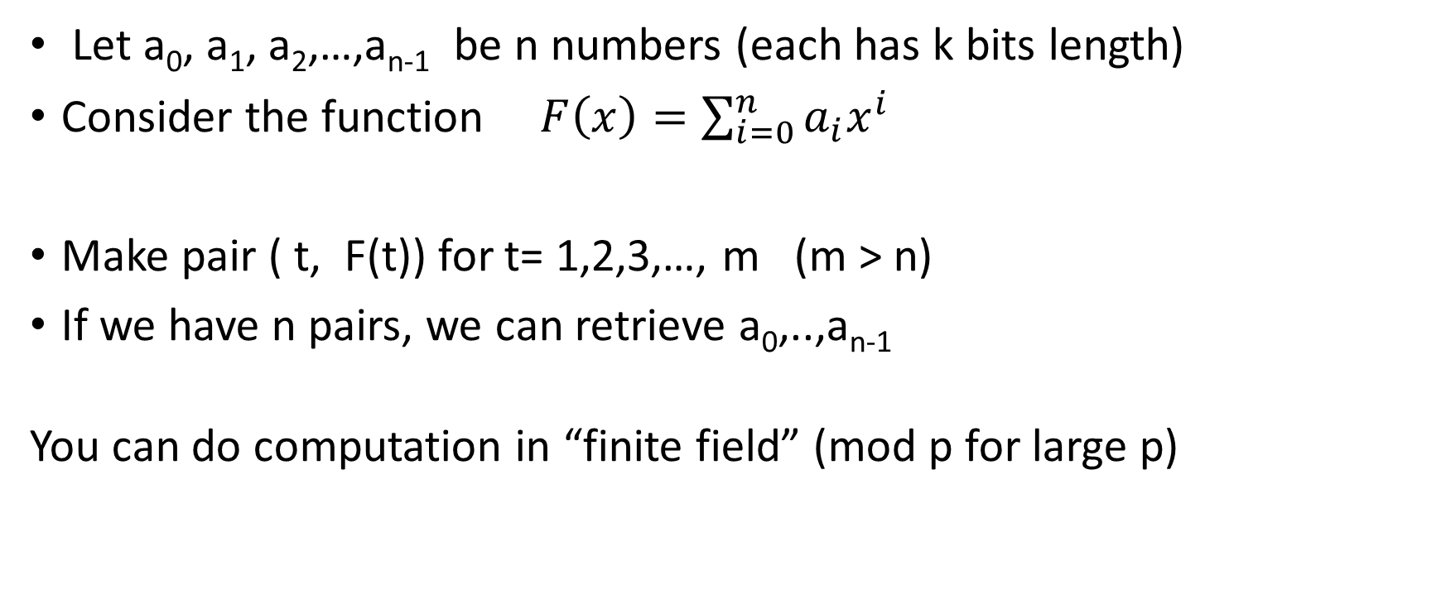
Reed Solomon code
Let a₀, a₁, a₂,…,a_{n-1} be n numbers (each has k bits length)
Consider the function $F\left(x\right)=\sum_{i=0}^{n}{a_{i}x^{i}}$
Make pair ( t, F(t)) for t= 1,2,3,…, m (m > n)
If we have n pairs, we can retrieve a₀,..,a_{n-1}
You can do computation in “finite field” (mod p for large p)

Slide 20

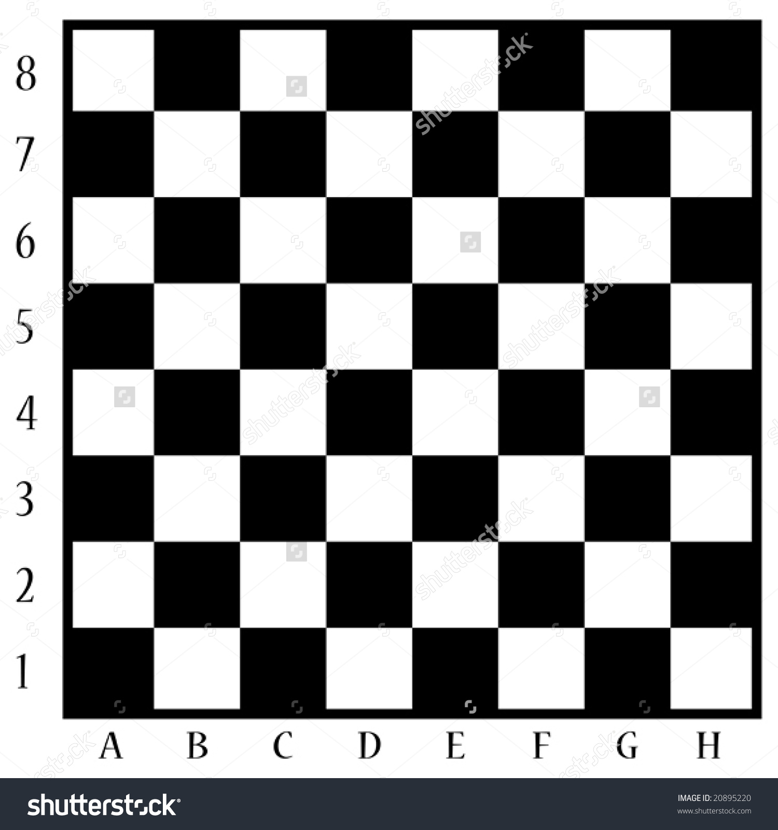
Coin flipping
・ 64 coins are located on a chess board choosing “face” or “tail”
Alice tells Bob a cell (say, D7) of the chessboard
Bob is allowed to flip one coin (he may do nothing)
Bob leaves the room.
Alice can align, but cannot flip any coin
Charlie comes in, sees the coins on the board
If Charlie can answer the location (D7), Bob-Charlie win
Otherwise, they fail
Give a strategy for Bob&Charlie

Slide 21
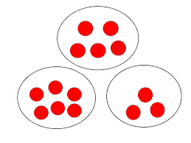
Nim game
Two player changes three piles of stones (say, 6,2,4) in turn
Each player subtract any number of stones from one pile.
The player clears the stones wins (there is a version that he loses)
What is your tactics
  Do you want to play first for (6,2,4)?
  Flash game

Slide 22
Red-blue hat again
You are a team of N students.
Each student are given red or blue hats randomly (with probability 0.5 red)
All the students shout “red” or “blue” or “pass” simultaneously.
If any student says wrong color, the team fails.
If all students say “pass”, the team fails.
In other words, at least one student says a color, and all students saying a color are correct, the team wins.
If N = 3, can you imagine a good strategy of the team?
If N = 7, what to do?
Hint: Perfect win is not possible. Please increase the winning probability.

