Slide 1
Invitation to theoretical computer science
写真等は講義のみに使用する目的で、WEBなどから転載しています。
Innovation by using mathematics
God used beautiful mathematics in creating the world.
Paul Dirac
Without mathematics, there's nothing you can do. Everything around you is mathematics.
Shakuntala Devi (Writer)
The most painful thing about mathematics is how far away you are from being able to use it after you have learned it.
James Newman (mathematical historian)

Slide 2
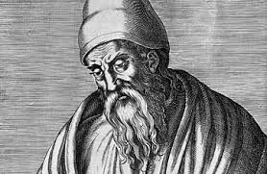
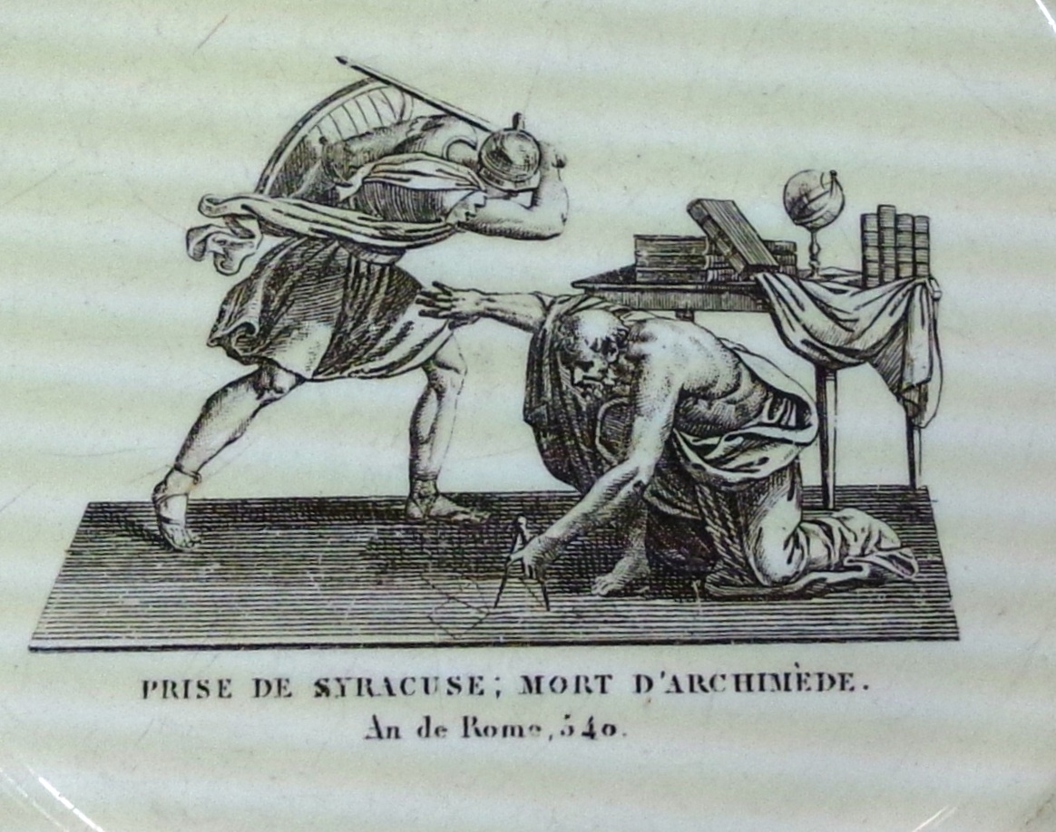
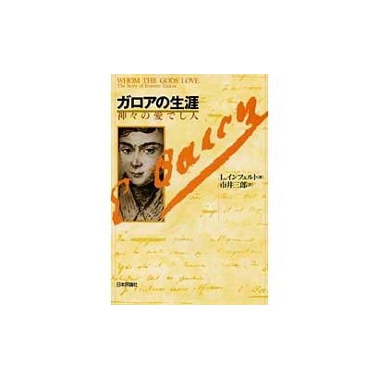
Math from life
Euclid (BC 3xx?—2xx?)
  Congruence, Angles, Area, Volume
  Elements of Geometry
  Why they are necessary in life?
Computation in Ancient Greece
  Computation by Ruler and Compus
  Addition, Multiplication, Subtraction, Division
  Can you draw a square of area 2?
    Pythagorean theorem
  Can you draw a cube of volume 2?
    Volume doubling problem
    Took 2000 years to solve, and develop mathematics
    Galois（1811-1832） theory to solve it
      Invented math for computers: Group, Finite Field
Archimedes:
Do not stump my circle
Whom the Gods love

Slide 3
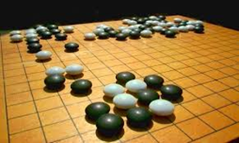
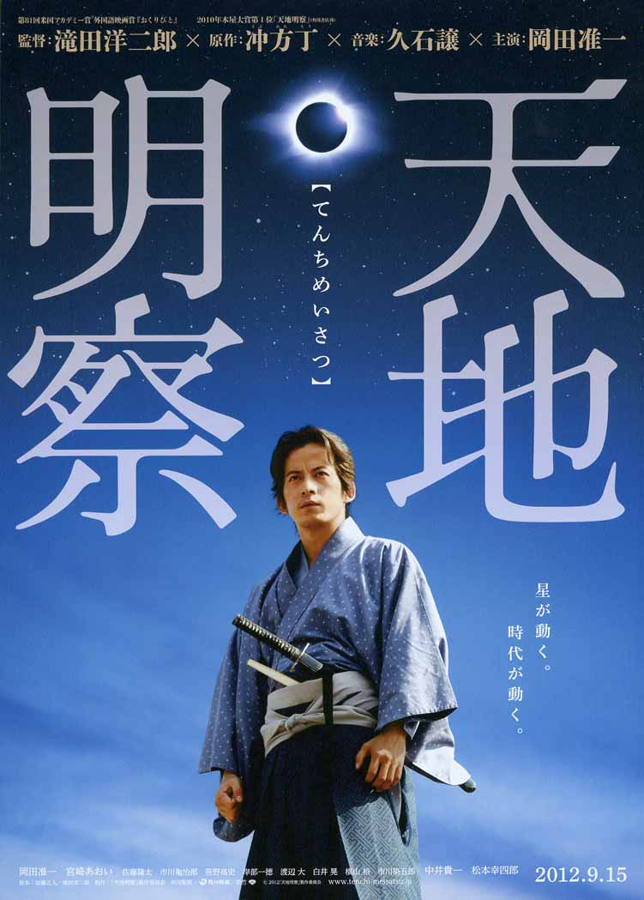
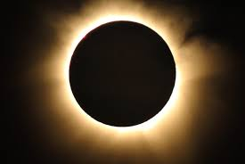
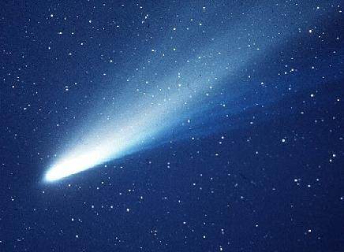
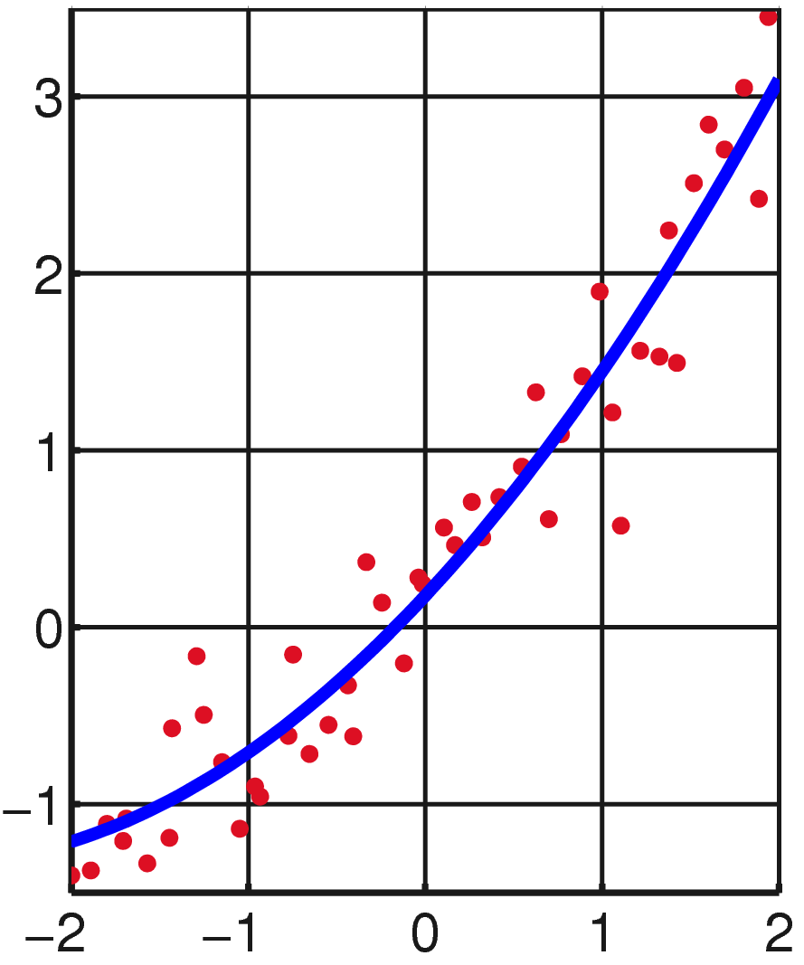
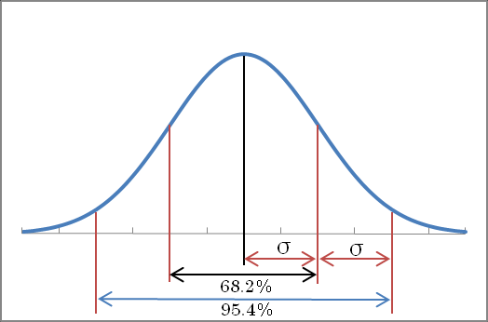
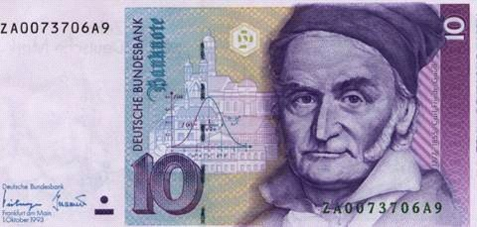
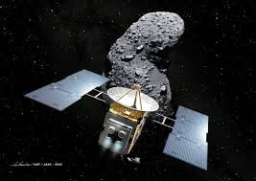
Big Data and Math：Astronomy
天地明察 (Tenchi Meisatsu)
  Harumi Shibukawa (渋川春海 1639-1735)
    Previous name: Santetsu Yasui (Professional Go player）
  Fix Japanese callnder (after 1000 years)
  Callendar is important in life (agriculture, business)
  Use mathematics for astronomy data analysis
Newton（1642－1727） Principia of mathematics
  Prediction of Harry comet （１６８２）
  Appearance：1758-9,1835,1910,1986,2061
  Differential Analysis for data analysis
Gauss( 1777－1855) invented math for statistics
  Prediction of Ceres asteroid （1801）
  Least square method, Gaussian distribution, etc
  Recent news on asteroid exploration
    Dawn Explored Ceres (2007-2015, NASA)
    Itokawa returned from Hayabusa（2010）
    Hayabusa ＩＩ departed for Ryugu(2014)
Mathematics as profession
  Above three were head of astronomical observatory
Math+Data: Engine of our world now!

Slide 4
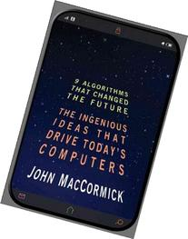
9 Algorithms that changes the future
Search Engine
  Finding needles in the world’s biggest haystack
Page Rank
  Technology that launched GOOGLE
Public-Key Cryptography
  Sｅｎｄｉｎｇ secrets on a postcard
Error correcting code
  Mistakes that fix themselves
Pattern recognition
  Learning from experiences
Data Compression
  Something from Nothing
Database
  The quest for consistency
Digital Signature
  Who really wrote this software?
What is computable?

Slide 5
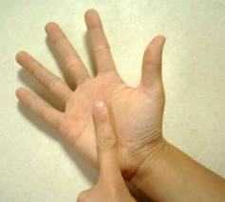
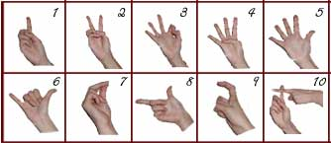
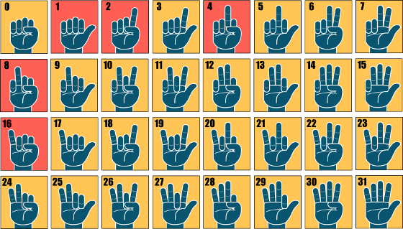
Numbering
Japan: fold the fingers
US-Europe: make the fingers
Problem： How far we can count by two hands?

Slide 6


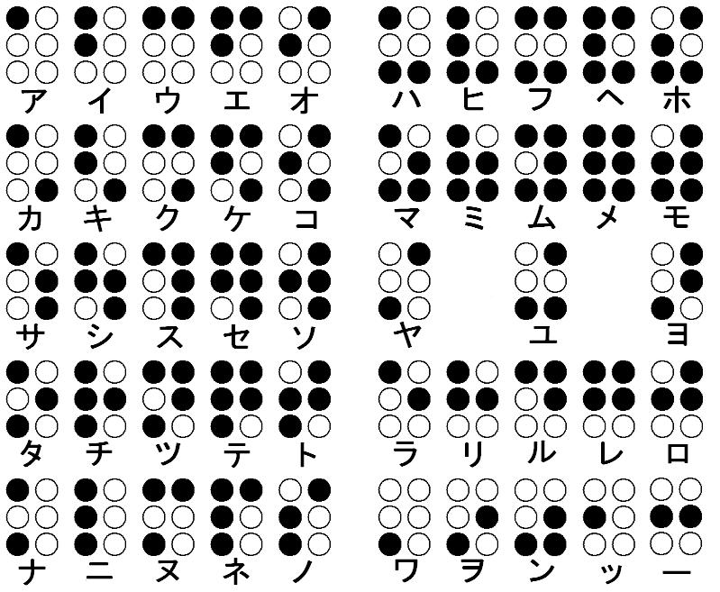
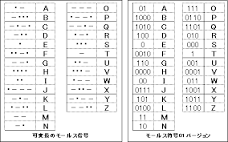
What we can see in life

Slide 7
Exercise: Guessing a card
Alice selects a card x (among 52 candidates)
Bob asks Alice at most k times
Alice answers Yes or No without telling a lie
Question： Can Bob surely finds x ? How large k should be?

Slide 8
A video
Cheko Asakawa

Slide 9
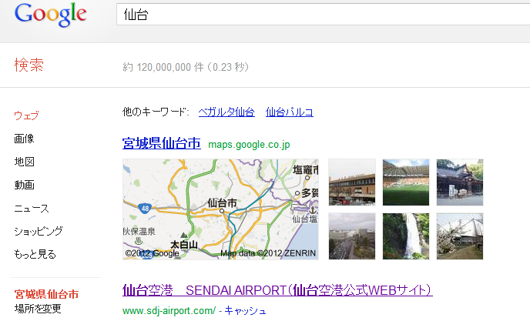
What is “searching data”
If you type “仙台” in a search engine. It will return about 100million hits of the web pages. How can it does?
  There are more than trillion webs = 1000,000,000,000
Even the fastest computer cannot search such large number of web directly.
Use the trick
  Card guessing

Slide 10
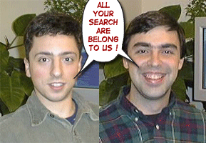


Indexing and Searching
Can we apply the card-finding trick?
Collect all the web page, and give an index
  Index： A table to indicate the appearance of each word
  How to order the index? How to handle a general search?
  ALTAVISTA system (1995)
How to select “good” candidates to show to the user
  PageRank Algorithm, which launched Google(1998)
Sergey Brin Larry Page
Supervisors:
Rajeev Motwani, Jeff Ulmann

Slide 11
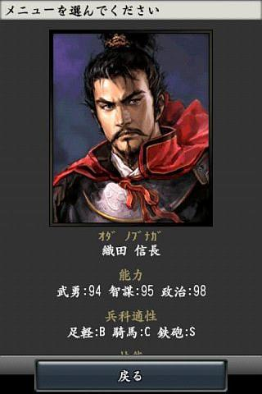
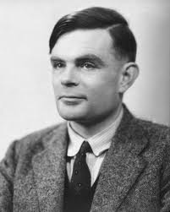
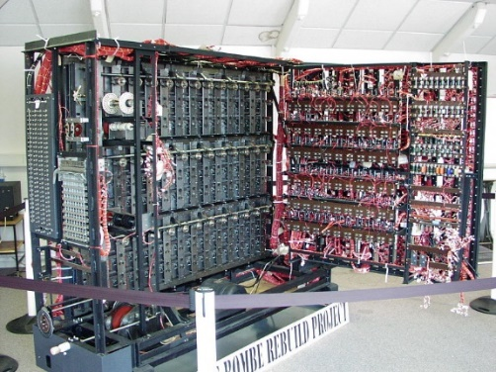
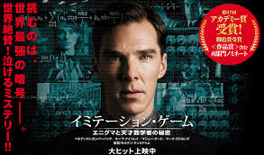
Information changes history
Decision based on information gave surprise in history
The war at Okehazama (Turning point of Japanese history)
  2 thousand vs 25 thousand (Oda vs Imagawa)
  Novel use of information by Nobunaga Oda
    Find the location of Imagawa headquarter, and immediately attacked
World War 2 (War of Science and Information)
  Cracking Enigma code was vital to win.
  Winston Churchill summoned scholars to Bletchley Park
    Alan Turing: Founder of the concept of computatability
      Decoding by using math and machine（Bombe)
      The Imitation Game: Academy award winning movie story
  U boats were destroyed by the code breaking
  Another interesting story: Operation “Mincemeat”
Data Science and Cyber Security
  Keywords for the future
    E-commerce
    Financial Engineering
    Weather/Disaster Prediction

Slide 12
Cryptography for Enigma
Character transformation (Weak crypto)
  TAKESHI
  T->A A-> B K->S E-> C S->P H->L I->D
  ABSCPLD
  Breakable by 『frequency analysis』
    Edger Alan Poe “The Gold Bug”
    “E” should be most frequent. “THE” is a frequent pattern
Masking code (Strong crypto)
  TAKESHI ⊕ 2018125 = VALMTJM
  TOUHOKU ->VOVQPNZ
  Theoretically we need to try all keys, but the key length is large
Enigma code： Masking code with a short key, but the key dynamically changes by a rule.

Slide 13
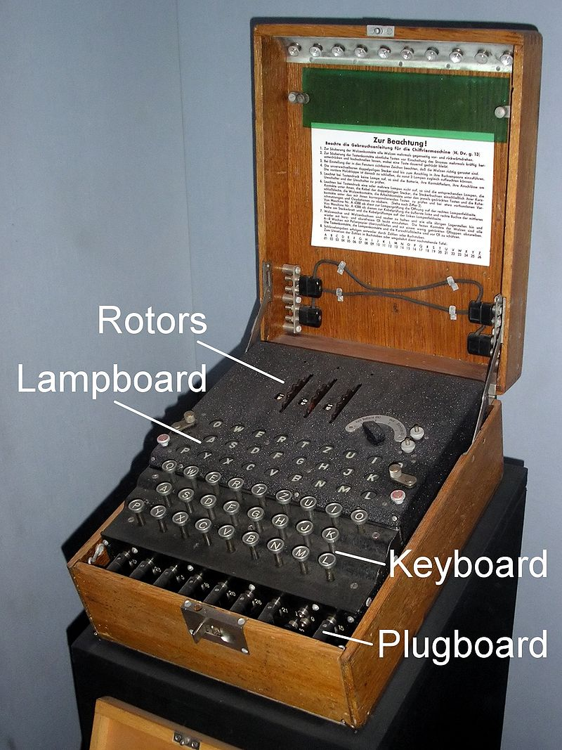
Design of Enigma code.
The following settings changes everyday
  Combination of three scramblers (three alphabets) =26³
    Provide different dynamic time-change of keys
  Choose three of five scramblers = 5・4・3 = 60
  Plugboard gives a code of length 6 to determine initial key = ₂₆ C ₆
  The combination
  ＝26³ × 60 × ₂₆ C ₆ ＝17576×60×100,391,791,500 ≒ 10,000,000,000,000,000
  Impossible to test all of them

Slide 14
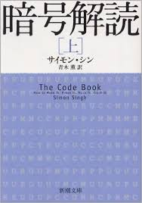
Why decoding enigma is difficult
  The novel idea of Turing
    Find an algorithm to eliminate the effect of plug code from a partial decoding of a document (at a fixed time)
      Utilize a tiny disclosure of the information (A security hole）
        German navy send the weather forecast 6am everyday
        The original document can be guessed
    An electrical circuit to execute the algorithm (The first computer!)
    Thus, we need to run the algorithm 12576 ｘ 60 times
    Do it in parallel as far as possible !
  Reading: 暗号解読 The code book （Simon Singh）

Slide 15
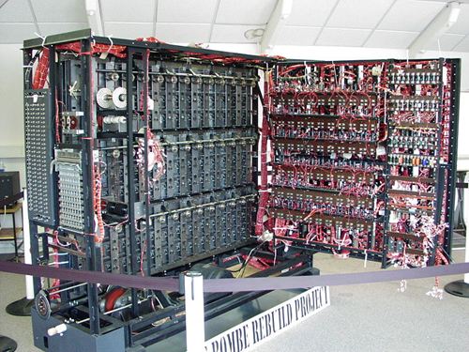
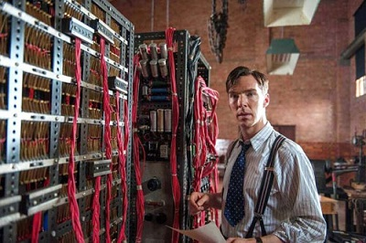

Slide 16

How to utilize the information
Red-Blue hat puzzle (NY times 2009/3/23）
  100 students ware red/blue hats and stand in a column
  Each student can see the hats of students ahead of him, but cannot see his own hat nor hats of students in his back
  Students call “red” or “blue” from the backmost one.
  A cookie is given for students to tell the correct color of his hat.
  How to maximize the number of cookies
The solution is easy in mathematics, but very useful
  A basic idea to utilize information
  Leads to “error correcting code” that is fundamental in information communication and data storage (such as music CD)

Slide 17
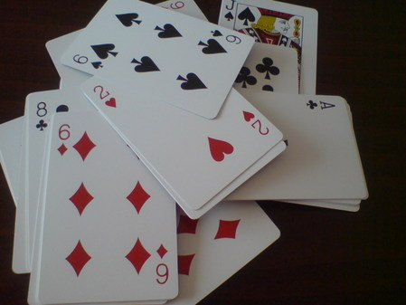
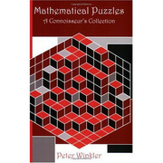
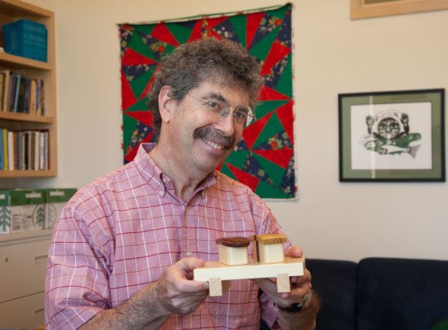
How you can gain in casino?
You should guess red-black of cards
The dealer shows the card one by one
  26 red an 26 black cards to the end of the deck
You have 10,000 yen and place the bet as you like
  You may just watch paying no fee
You should “surely” gain as much as possible
  Prepare for the “worst scenario”
  The dealer might choose the card as he likes
You should pay 20,000 yen for the entrance fee

Slide 18
The first strategy
You count the card
  (r,b)： The pair of numbers of appearance of red and blue cards
Wait until the last card
  You know the color of the last card
  You gain 10,000 yen
    (Unfortunately, less than the entrance fee）

Slide 19
The second strategy
Wait until the last three cards
If the last three cards are all red (or all blue), you are lucky
  You increase your money to 80,000 yen, thus gain 70,000 yen
What happens if the rest are (2,1) (two red, one black)
Try to bet 3000 yen for red.
  If you win, you have 13000 yen in hand
    Watch once, and bet to the last card → 26000 yen
  If you lose, you have 7000 yen in hand
  Both the remaining cards are red, and you can double it twice
    You will have 28000 yen
Take balance, and bet １００００/３ yen
  You surely have ８００００/3 = 26666円
Gain is 16666 yen, not enough for the entrance fee

Slide 20
The third strategy
Wait for the last five cards.
Say, 3 red and 2 black cards remain
How much you bet (to which color)
How much you can gain?
Can you design a general strategy from the experiment?

Slide 21
If we do not care the risk
Just consider the expectation
「ALL-IN」
  Fix one possible sequence of 52 cards (26 red, 26 black)
  Bet all you have according to the sequence
  You will have astronomical money if you win
  ２⁵² x 10000 yen： 60,000,000,000,000,000,000 yen
  Expectation: divide by the number of combinations
  ２⁵² / ₅₂C₂₆
  This is much larger than 1
Impossible to do (since, the casino bankrupts)
Risk hedge: Turn gamble to “safe” investment

Slide 22
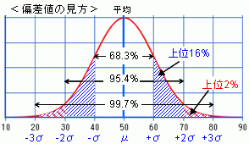
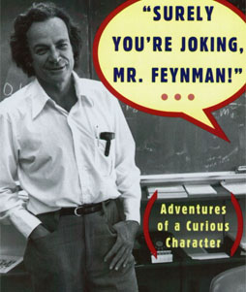
How large 2⁵² ÷ ₅₂C₂₆ ??
₅₂C₂₆ ≒ 2⁵² ÷ （26π）^{0.5}（Central limit theorem）
2⁵² ÷ ₅₂C₂₆ ≒ （81.68）^{0.5}
≒ 9
You can compute faster than calculator
R．P．Feynman “Surely You’re Joking, Mr． Feynman”
Answer any computation problem in 60 second (within 10% error) if you imagine the problem in 10 second.
Example: coefficient of x¹⁰ of （1＋x）²⁰

Slide 23
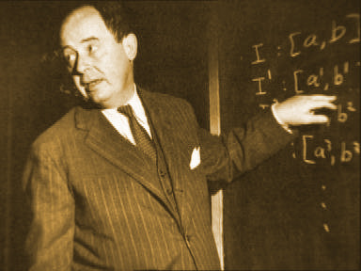
Analysis of our game
Risk hedge of gambler’s method
  Divide your money into all possible combinations
  Run “All IN” in parallel
  Aggregate the stake money
How much you win→80,000 yen （excluding original 10,000）
Show that this is equivalent to our previous strategy
Turn mathematics into money: Game Theory
  John von Neumann : Computer architecture/algorithm/simulation, mathematics, quantum physics, meteorology(気象学）, nuclear bomb (Manhattan project)
Mathematics is the most important technology
  Many of Nobel prize winners in Economics are mathematicians
  Mathematics is key to success in business and financial market
  Data Scientist: The sexiest job of the 21st century (Harvard Business Review 2012)

Slide 24
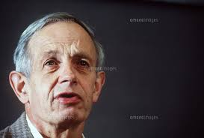
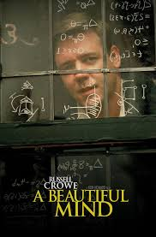
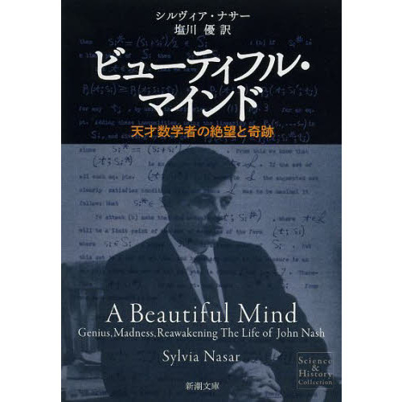
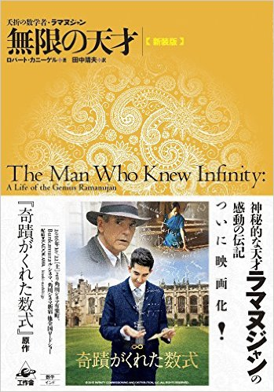
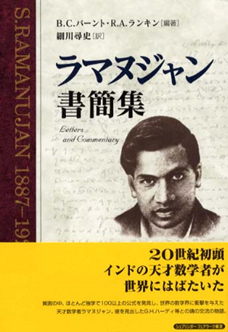
  A beautiful Mind: (2001)
    Academy prize winning movie
    John Forbes Nash (1928-2015)
    Fields medal candidate (manifold embedding and differential equations) but missed it
    Stopped publication after 1958
    1994 Nobel prize
      Equilibrium Points in N-person Games (1950)
    2014 Abel award (Highest prize in math)
    2015 Died by traffic accident (with his wife)
  The man who knew Infinity (2015)
    Srinivasa Ramanujan (1887 -1920)
      “real genius in mathematics”
      Goddess inspires him formulas..
      Needed 75 years to understand works given in his three notebooks
      Ramanujan’s “Lost notebook” is still miracle
        A series of papers by George Andrews et.al. (part IV in 2013)
      Ramanujan Graph: A key tool in computer algorithms and architecture

Slide 25
