Slide 1
Machine learning
AlphaGo and learning methods

Slide 2
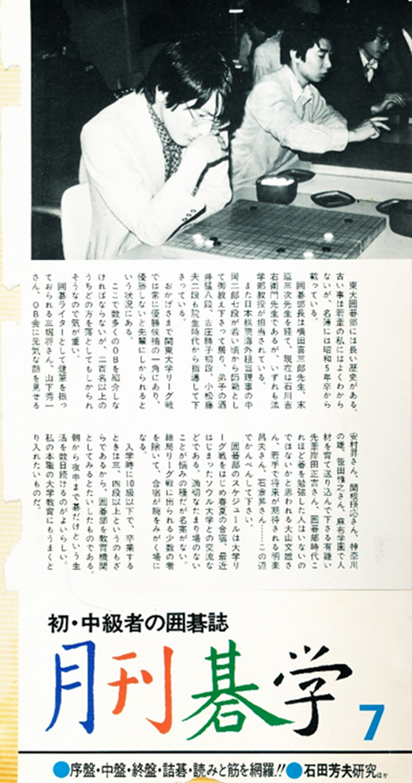
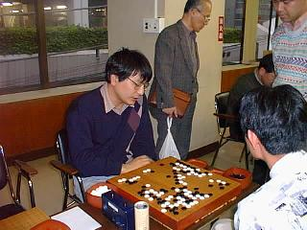
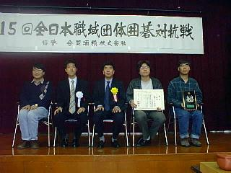
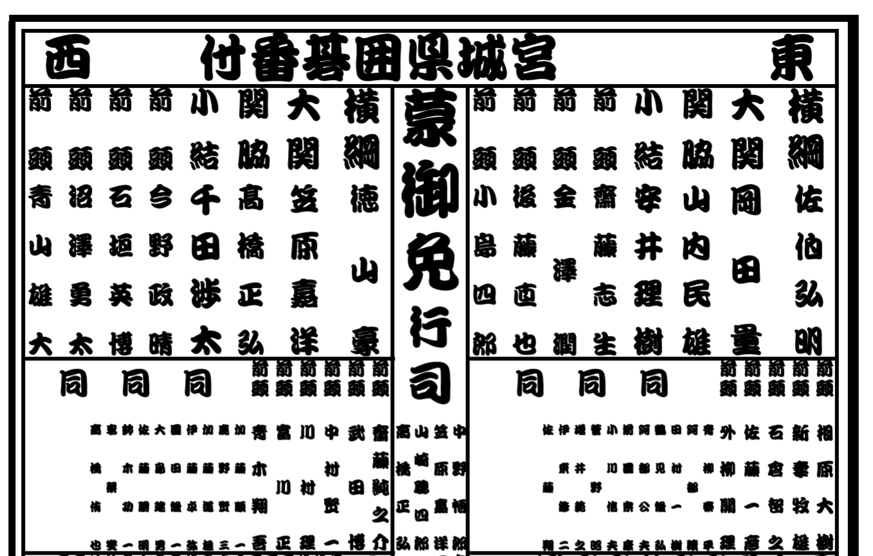
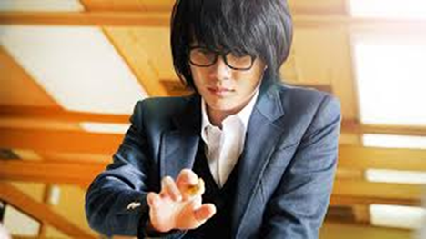
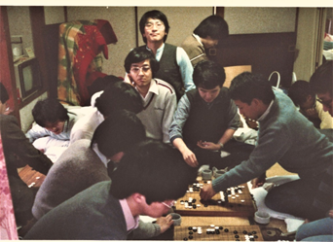

An animation hero resemble to my youth
Ranking in Miyagi prefecture 2016

Slide 3
Rule of Go
Go: A game between two persons: Bob(black) and Willy(white)
Bob and Willy alternatingly place stones on 19 x 19 grid board: Bob places black and Willy places white stones
Stones cannot move, but stones completely surrounded by opponent’s stones are removed from the board
The game terminate if there is no ”profitable” move.
  Or by resignation
The one with more “territory” wins
  Bob plays first, and gives 6.5 handicap points to Willy
There is an additional rule named “Ko(劫, meaning infitite time) ”to avoid infinite loop.

Slide 4
Mathematical formulation
Finite deterministic two-person’s zero-sum game with complete information
  Theorem: There is a winning strategy (different from Poker, Mahjong etc)
s: state of go = placement of stones on 19 x 19 board
  s is a 361 dimensional vector of (1, -1, 0) . 1 means black, -1 means white, 0 means no stone. (special treatment for “Ko”)
  The number is bounded by 3 ³⁶¹
a: next move. A grid point not occupied in the current state.
F(s): Function indicating Bob win (1, or b) or Willy win (-1, or w) or draw (0)
  Draw happens very rare (once in 10000 games or so), and let us ignore it.
Winning move a (for Bob) at s satisfies F(s ∪ {a}) = b
  If F(s) = b and its Bob’s turn, there exists a such that F(s ∪ {a}) = b
  If F(s)= b and its Willy’s turn, F(s ∪ {a}) = b for every possibly Willy’s move a.
Practically, we consider a function f(s) to indicate the “advantage” for Bob at s
  E.g., winning probability, difference of territory, etc.

Slide 5
Game tree
Tree indicating how the play proceeds
  The depth of the tree is bounded by 361 (a bit cheating)
  Each node has at most 361 children nodes
Indicate the function F (or f)
Game= path from root to a leaf
  node at odd depth : Bob’s play node at even depth: Willy’s play
Each leaf indicates Bob win (F=b) or Willy win (F=w)
If an odd depth node u has a child node u of F(v)= b, then F(u)= b, else F(u)= w
If an even depth node u has a child node v of F(v)=w, then F(u)=w, else F(u)= b

Slide 6
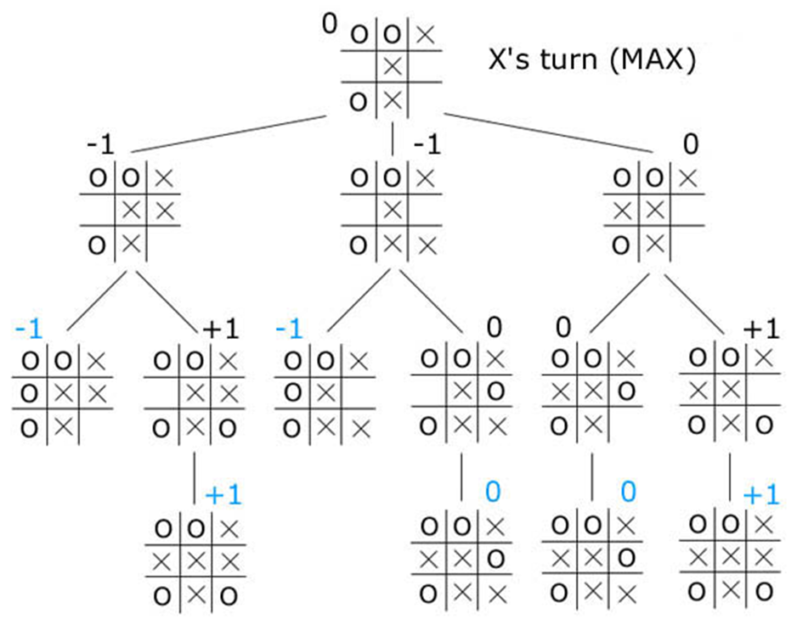
A part of the game tree of Tic Tac Toe

Slide 7
Method outline of Go softwares
Game-tree search
  Exhaustive search
  Depth-bounded exhaustive search with position evaluation function
    Find the play to lead to the “best leaf “ in a subtree
    Strategy of Deep Blue Chess machine, which won against Kasparov in 1997.
  How to give the position evaluation
    Linear combination of several basic functions in Chess
    In Bonanza system which won against professional Japanese Chess, machine learning was introduced to give the position evaluation.
  Monte Carlo rollout
    Try real play many times, and find out the probability of win
    Looks silly, but gave the first human level Go machine
    If player in the rollout is stronger, then the probability becomes more accurate
  Monte Carlo Tree Search (MCTS)
    Give/improve evaluation of position by using Monte Carlo rollou
    If players become strong, then it further improve the system by using stronger players in Monte Carlo rollout
  Idea of Alpha Go: Use deep neural network to represent evaluation functions

Slide 8
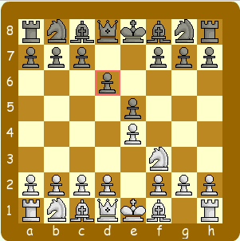
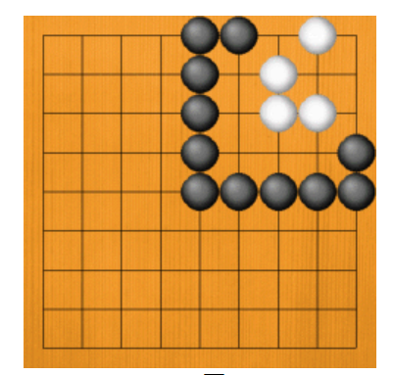
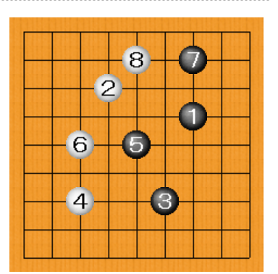
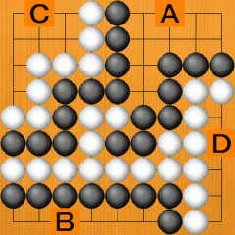
Evaluation functions
Chess: Evaluation of pieces and position
  Pone= 1, Knight = 3, Bishop=3, Rook=5, Queen=9, King=∞
  Position: How many possible moves? Connection of pieces?
Go: Difficult to find a good function
  Objective: Territory (which part is your territory?)
  Stones : Alive or Dead

Slide 9
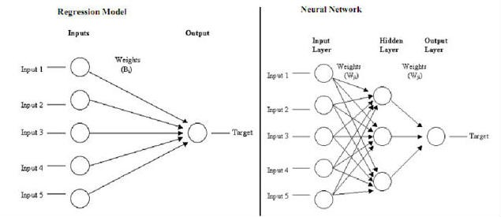
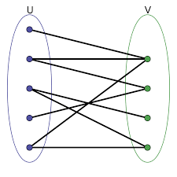
Function represented by a network
Linear function: y = Ax (y: m-dim vector, x: n-dim vector)
Find the best weights: linear equation???
  Regression analysis
Multi-layer network → matrix multiplication

Slide 10
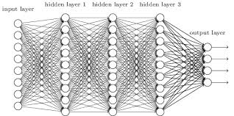
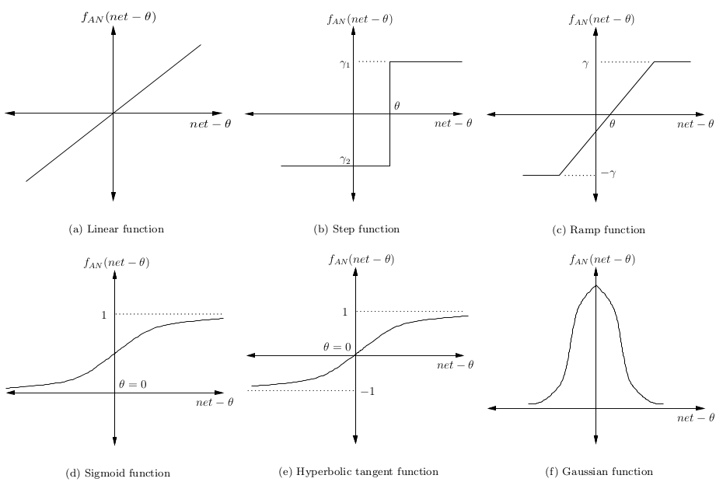
Neural network
Represent nonlinear functions
(nonlinear) node functions
  Threshold function (step function)
    If the incoming value exceeds a threshold, it becomes 1, otherwise 0
  Sigmoid function
Node functions are fixed
Edge weights are “learned by data”
  Back propagation algorithms

Slide 11
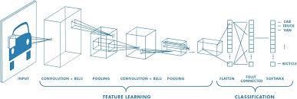
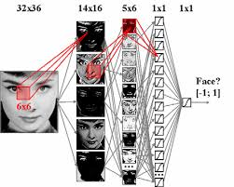
Convolutional Neural Network (CNN)
Good for image recognition
Input: A vector forming in the shape of rectangular array
K-th layer node: A template set of smaller arrays
  Feature vectors of textures, shape, direction, etc
  Compute the matching function of input and templates

Slide 12
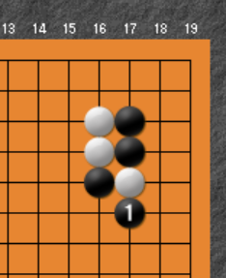
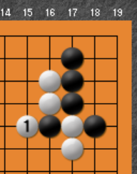
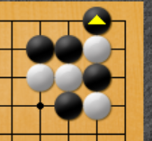
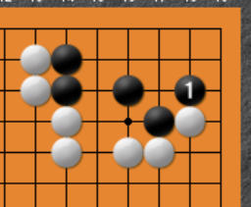
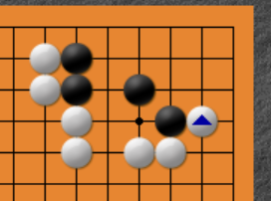
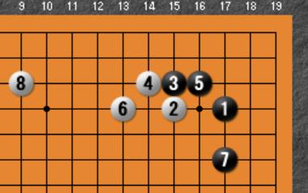
Go game as image processing
What are good moves?
Easy cases for human/machine
  Capturing opponent’s stones
    Local and featured patterns
    Ladder (Local but global)
  Guarding territory
  “Jyoseki”
    Frequent patterns developed by human (2500 years history)

Slide 13
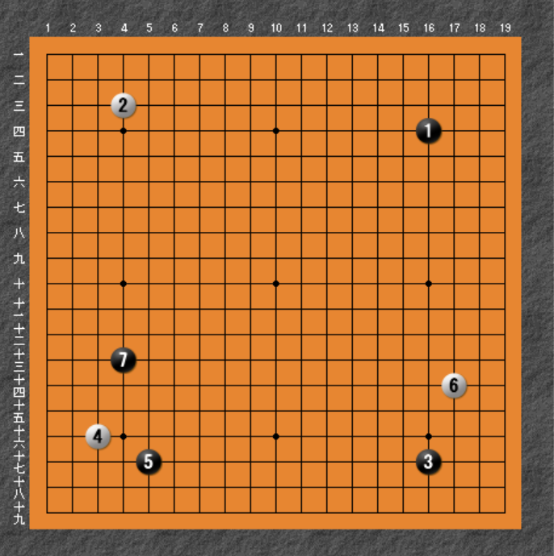
Global pattern recognition
Opening patterns
  What is the value of move 7
    A decent move
    Probably not the best move
    No one knows!
  Good evaluation function is hard to design
  But, good player feels
    This move is beautiful, thus should be nice!
Global features and local features
  Similar to image processing
  Thus, CNN looks nice to use!

Slide 14
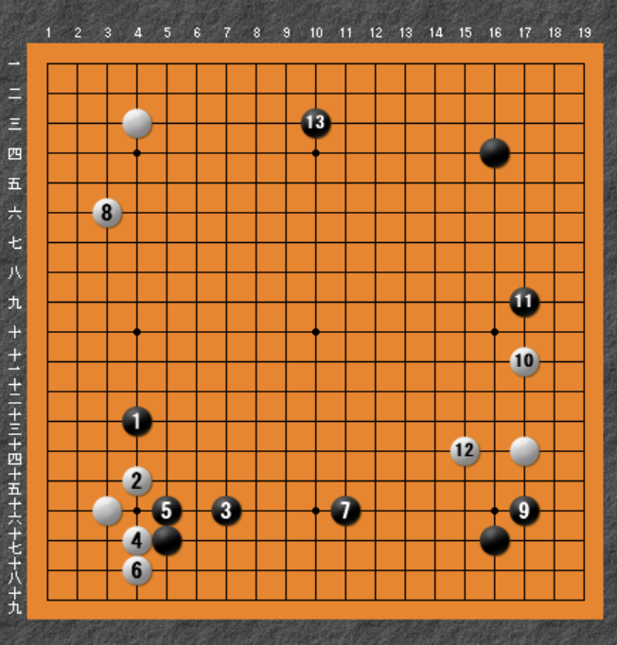
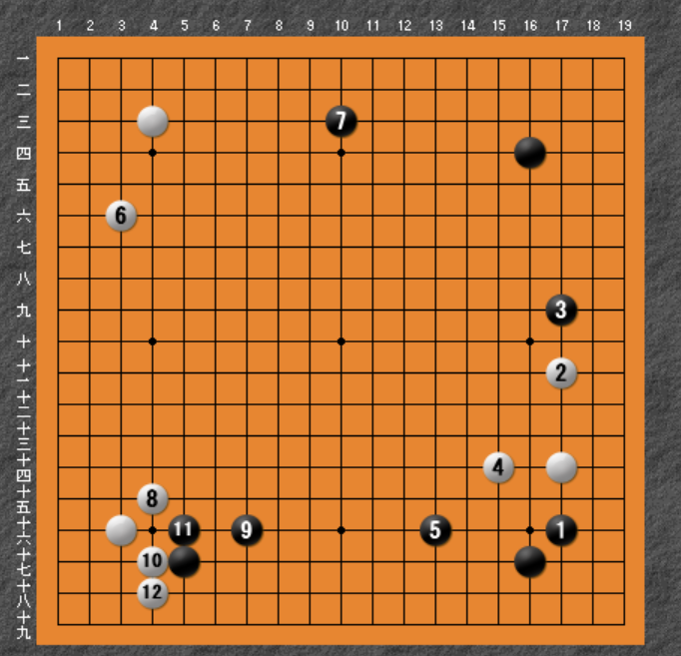
Humans evaluation (what I do)
Imagine expected variations
Compare with games you know or think “even”
Do relative evaluation

Slide 15
Small difference matters a lot
Fighting !
  Death or alive
Different from image processing
  In image processing, small bit flips do not matter
  But in Go, small difference matters a lot.
    Ladder is a typical example.
Thus, MCTS tree search is necessary
  Human players also do it!

Slide 16
Basic design
You can use CNN for the learning mechanism to give pattern matching of go position
  p(a,s) : the move probability of a at the position s
  v(s): the “value” of position s
  The parameter θ of CNN can be modified.
  f(s)= f _{θ}(s) = (p(a,s), v(s)) depends on θ
How to design the system?? (question to students)
  Supervised learning : AlphaGo
    Utilize 160000 games in the database of strong human players
  Unsupervised learning : AlphaGo zero
  Reinforced learning -> to make a weak learning system stronger

Slide 17
Short of data and two solutions
Obstacle: short of data
  Human play data is too small compared with the number of possible positions
  Data of good players is too biased (only nearly tie positions are given)
  But, random data is not suitable, considering huge number of possibility
  So, we are short of data for the complete supervised learning
So, we should make “good data” by using computer simulation
  Solution 1. Semi-supervised learning with “Simulation data with data assimilation”
  Solution 2. Unsupervised learning

Slide 18
AlphaGo: Semi-supervised learning with simulation
Method: A kind of “data assimilation”.
Make a system to find the next move (with probability), named policy network
  Learn 30,000,000 positions (170,000 games) of human professional (or near-professional) Go players to have an initial policy network
  Make “old version crones” of policy network, and play with them
    Divided into 10,000 stages
    In each stage, the player (which we want to educate) plays 128 games with randomly chosen players among its old versions.
    Seeing the outcome at each position, tune the parameter of CNN
Make a value-network to show winning probability of each positions.
    Monte-Carlo tree search by using strong policy networks to find winning probability of many positions.
    Use CNN to lean from this (huge) data
Final play: combine policy network, value network, and MCTS

Slide 19
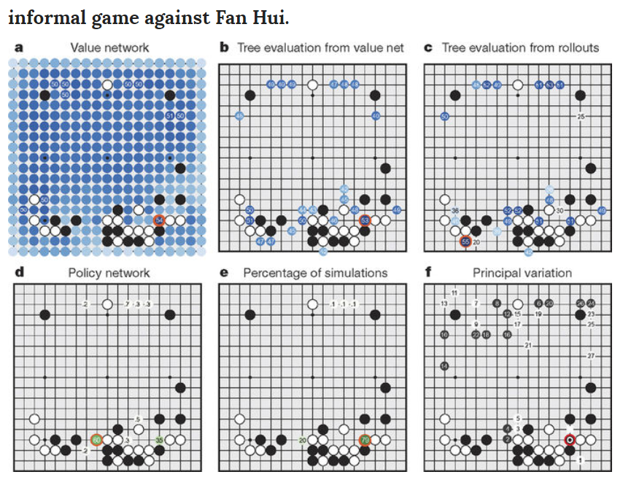

Slide 20
Solution 2. AlphaGo-Zero : Unsupervised leaning
  CNN combining policy network and value network
  Start from many CNN with random parameters.
  Leaning is divided into periods
    Choose an “evaluator” for each “period”
    The evaluator make 25000 self play in parallel
      Use 1600 MCTS simulations at each move (only spending 0.4 second)
    Other player learns from the data of evaluator’s play
    Each player challenges to the evaluator (250 games each)
    The most winning one replaces the evaluator
  How it improves

