Slide 1
Intersection problem

Slide 2
A quiz
Given three points a=(3,7), b=(-1,5), c= (2,12), compute
the area of the triangle abc.

Slide 3
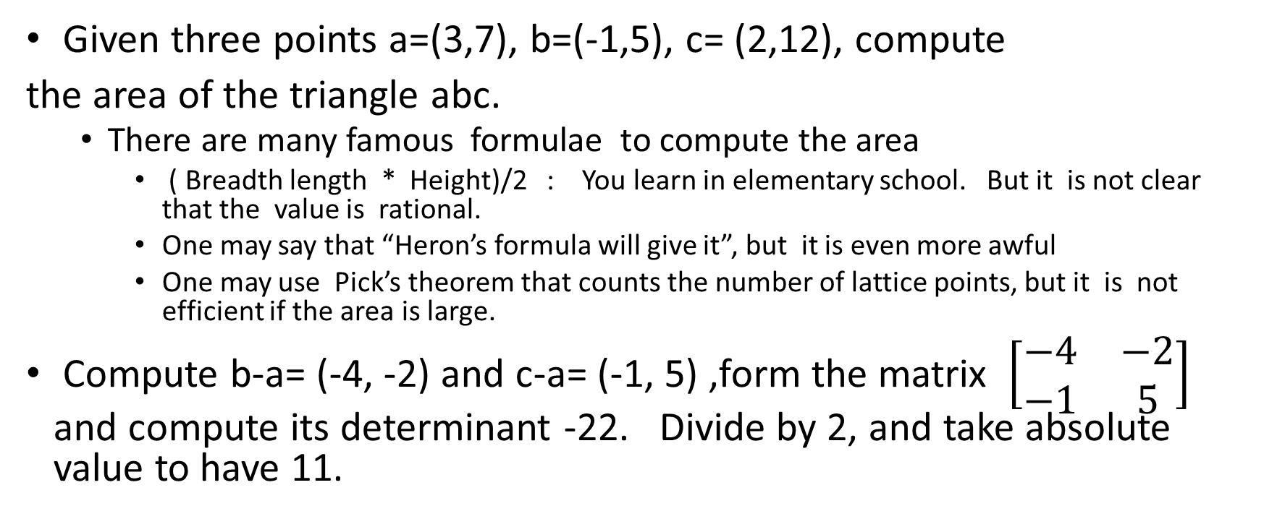
Solution
Given three points a=(3,7), b=(-1,5), c= (2,12), compute
the area of the triangle abc.
  There are many famous formulae to compute the area
    ( Breadth length * Height)/2 : You learn in elementary school. But it is not clear that the value is rational.
    One may say that “Heron’s formula will give it”, but it is even more awful
    One may use Pick’s theorem that counts the number of lattice points, but it is not efficient if the area is large.
Compute b-a= (-4, -2) and c-a= (-1, 5) ,form the matrix $\left[\begin{matrix}−4 & −2 \\ −1 & 5\end{matrix}\right]$ and compute its determinant -22. Divide by 2, and take absolute value to have 11.

Slide 4
Intersection and plane sweep
Given a set S of n (open) line segments s(1), s(2),…, s(n), detect whether there is any intersection, where s(i) = (p(i), q(i))
Given a set S of n axis-aligned rectangles R(1),R(2),..,R(n), detect whether there is any intersection
Mathematical model to detect short-circuit of an electric circuit.
  A tool in CAD system for LSI design (very popular in 1980 th)

Slide 5
How to detect intersection of two segments?
Area of triangle
Area (a,b,c) = |det (b-a, c-a)|/2
Given three points a, b, and c
  Left (a ; b,c ) = 1 if a is on the left of the line bc
  = -1 if a is on the right of the line bc
  = 0 if a is on the line bc
  Claim: Left(a; b,c) = 0 if Area (a,b,c) = 0
  Otherwise, Left(a; b,c) = det(b-a, c-a) / 2Area(a,b,c) = sign (det(b-a))
Given two open segments s = (a,b) and s’= (c,d) not on a same line, they intersect only if Left(a; c, d) Left(b; c,d) = -1 and Left(c; a,b) Left(d; a,b) = -1
This procedure IntDetect(s, s’) runs in constant time.

Slide 6
Naïve method to detect intersection of segments
For each pair s,s’ of segments, run IntDetect(s,s’)
O(n²) time
If n = 1000000 (usual in LSI CAD design), if we can reduce it to
O(n log n), we can speed up the response time by a factor of 10000 or more. ( that is, 1 sec to 0.1 msec)
Bentley-Ottman sweep algorithm can attain it.

Slide 7
Plane sweeping
Given n geometric objects (say, n line segments)
Move a vertical sweep line, and describe the intersection of objects and the sweep line
  If n line segments, intersection is at most n points
Trace the change of the intersection
  If n line segments, we consider the change of sorting order of intersections
Shamos-Hoey algorithm (1976) detect san intersection in O( n log n) time
Bentley-Ottmann algorithm r1979) reports all intersections in O((n+K) log n) time, where K is the number of intersections.

Slide 10
Idea : When two line segments s and s’ become adjacent on the sweep line, we call IntDetect (s, s’)

Slide 12
Maintain the list of crossings of segments at sweep line, and call IntDetect (s, pre(s)) and IntDetec(s, succ(s)) for the updated s.
Succ(s)
s
Pred(s)

Slide 13
Maintain the crossing order at sweep line
Exchange(b,c)
Delete(a)
a
Insert(b)
Use balanced binary search tree to maintain the crossing order
Use priority queue to maintain the future locations of change of sweep line
c

Slide 14
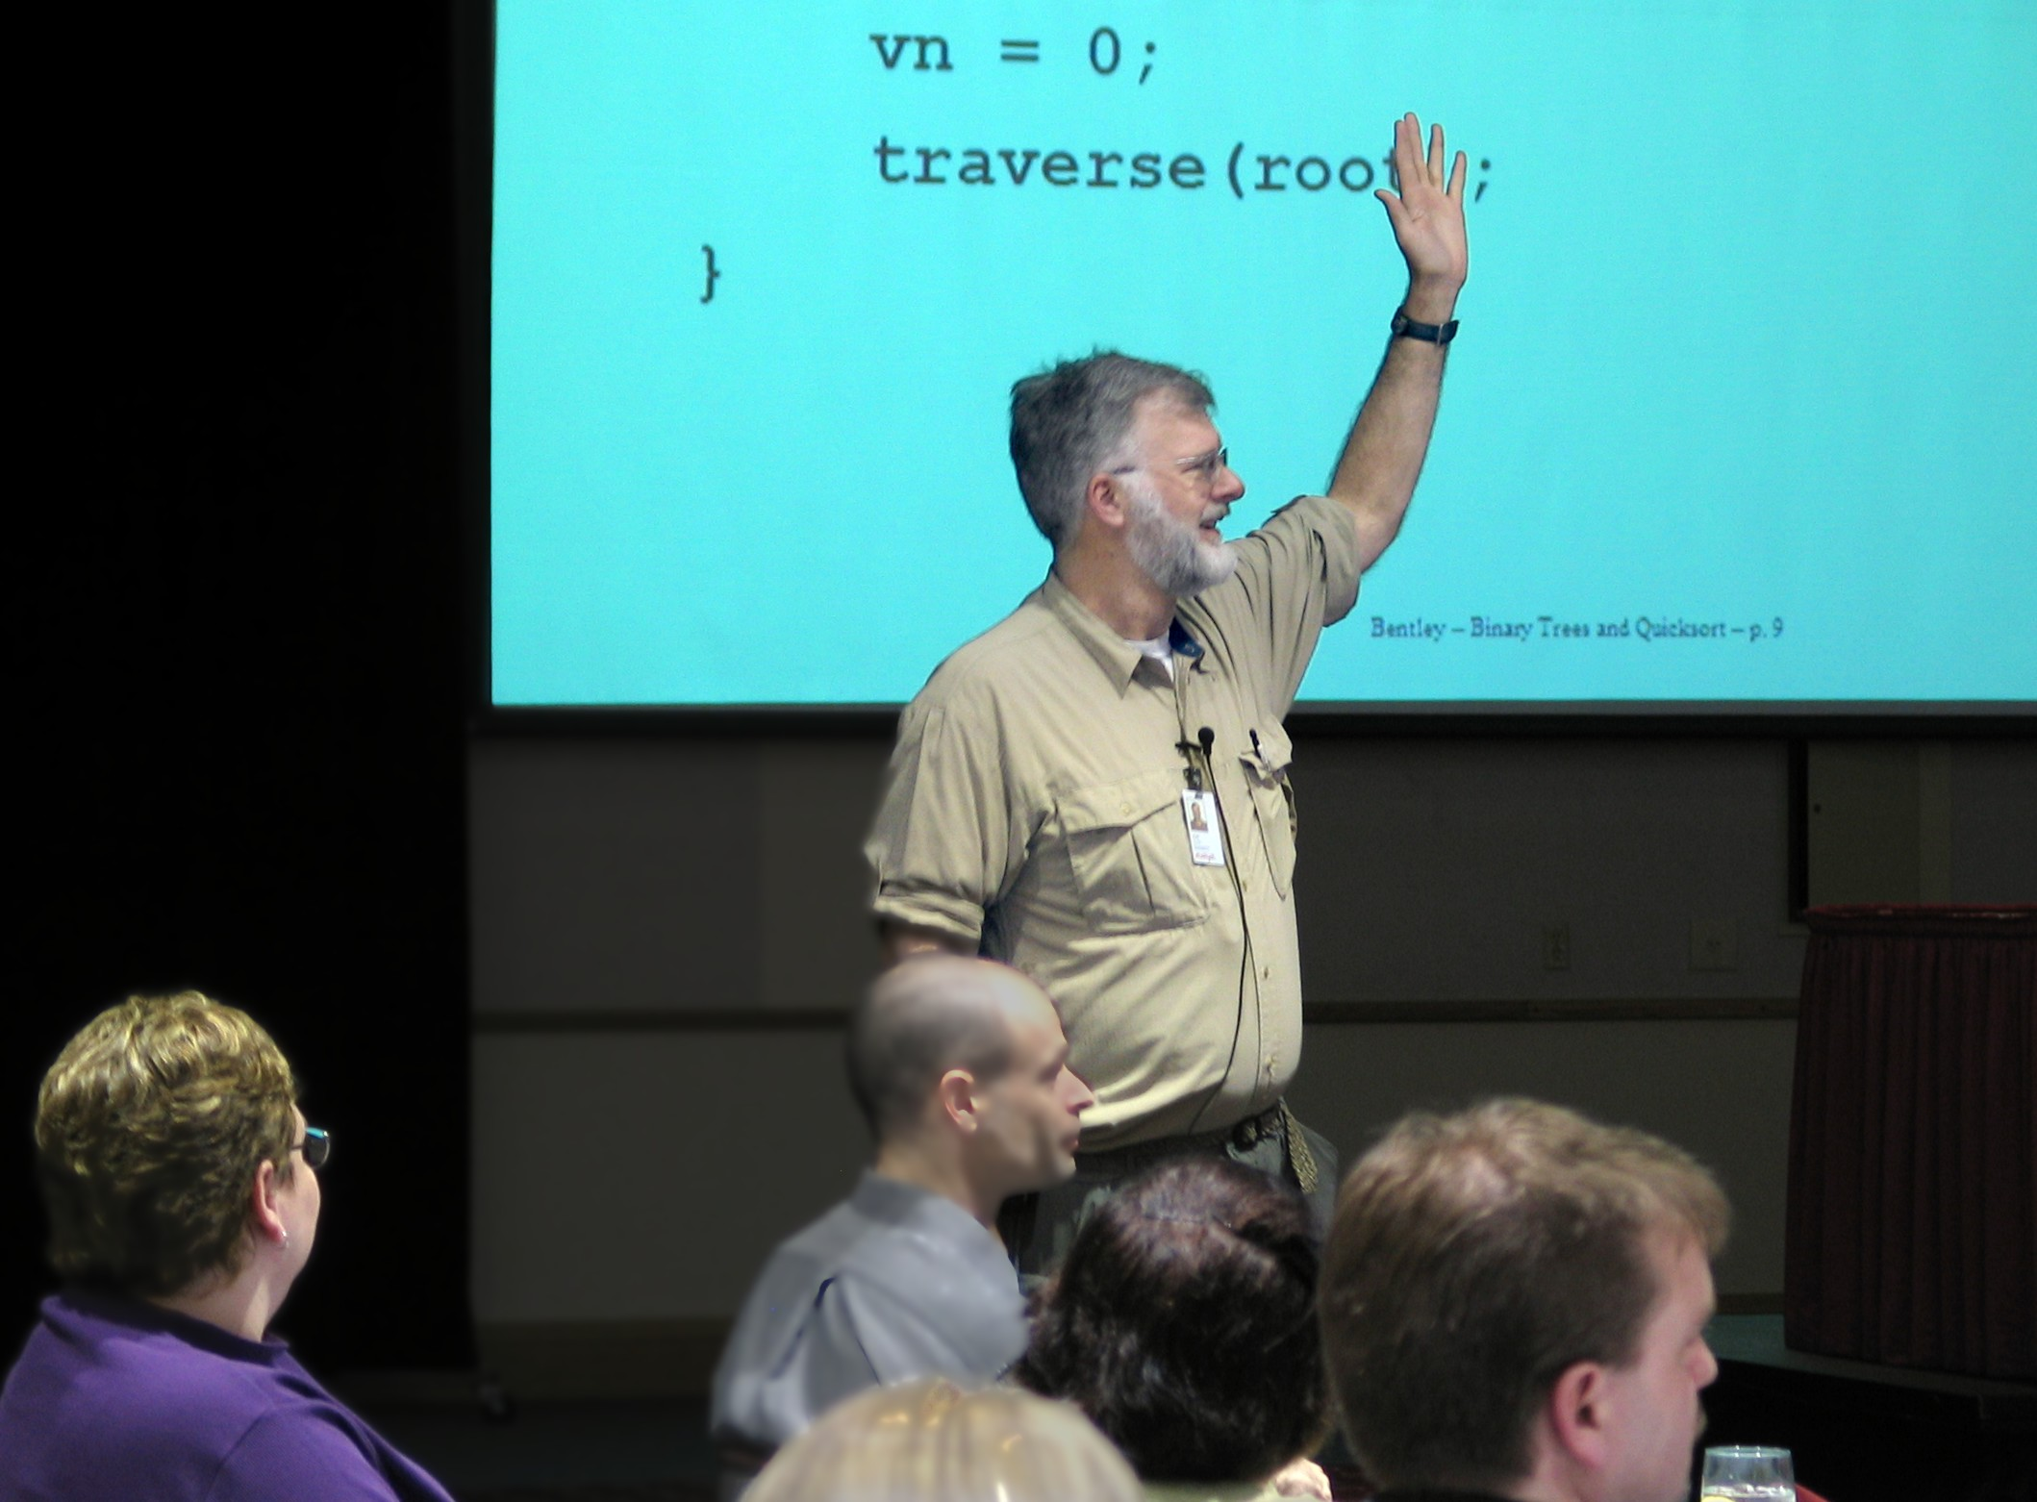

Bentley-Ottmann’s plane sweep algorithm
John Bentley: Computer scientist (CMU and ATT Bell Laboratory)
  Superstar “programmer” created several algorithmic methods
    Interval tree, kd- tree, etc
    “Programming Pearls” is his book containing many nice tips for you
Bentley-Ottmann’s algorithm works for intersection
of any objects (rectangles, triangles, polygons, etc)
  Time complexity is Ｏ( n log n + K log n), where K is the number
  of intersections.
  Optimal if K < n , but this is not the end of story.
  If K is very large , it might be slower thant the naïve algorithm
  O( n log n + K) should be the best possible, and how to attain it?

Slide 15
O( n log n + K) time algorithms
Chazelle-Edelsbrunner’s algorithm (1988) attains O( n log n + K)
  Two “superstars” in computational geometry
    Bernard Chazelle
    Herbert Edelsbrunner
  Use trapezoidal decomposition
  Extremely difficult algorithm , and no one seriously implemented
Mulmuley’s randomized algorithm (1988) to attain O( n log n + K)
  Easier to implement, but need randomization
Balaban’s algorithm (1995)
  Easier than Chazelle-Edelsbrunner

Slide 16
Is O( n log n ) time fast enough ?
For detecting the intersection, O( n log n) is often too slow
Say robots moves, and judge that they do not collide (at a given time t) obstacles (and other robots).
If the robots are 2-dimensional objects defined by polygon, intersection detection of line segments defining the boundary of the polygon works (in O( n log n) time).
  But, of course faster is better
If we consider 3D (imagine many drones flying in a forest), the problem is more complicated.
One solution: Approximate objects by convex objects (with some structure)
  Intersection of convex polygons (or polytopes) can be done much faster.

Slide 17
Intersection of two convex polygons
P, Q convex polygons
The list of edges in counter-clockwise order is given for each polygon
Then, the intersection can be detected in O( log n) time, where n is the number of edges.
Extend P at top and bottom vertices to the right (resp. left)
with horizontal lines to have open polygons P(R) and P(L).
  Similarly, Q(R) and Q(L)
Lemma (prove it !)
P intersects Q if and only P(R) intersects Q(L) and
P(L) intersects Q(R)
Then, a clever binary-search algorithm works
  Hope that everyone knows binary searching
  Eliminating half (or constant portion) of data in O(1) step.

Slide 18
Intersection of polytopes in 3D
Given two polytopes P and Q
  We can preprocess them in O( n log n) time to make a data structure for efficient intersection
  This data structure can be used if the polytopes are moved (translation, rotation, scaling)
A sophisticated O( log n) time algorithm was given by Dobkin and Kirkpatrick in 1983.
  Not too much difficult to read the paper, but it is difficult to explain to you by a lecture.

