Slide 1
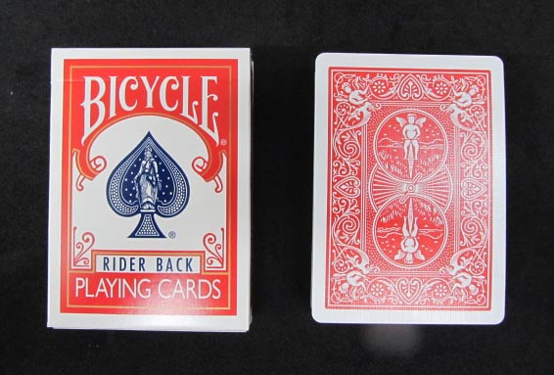

Guessing a card
Alice hides a card x
Bob asks Yes-No questions to Alice k times
Alice honestly answer Yes or No
Find a strategy to attain minimum k

Slide 2




Data query
You type “仙台” to obtain info in 0.2 seconds. How to attain this?
  The number of Web sites exceeds 50 billion
  The number of Web pages exceeds trillion Naturally, O(n) algorithm is too slow.
A similar idea to binary searching works (Altavista) to find 100M candidates
Then, the page-rank algorithm of Google selects what you want.
Sergey Brin Larry Page
Rajeev Motwani, Jeff Ulmann

Slide 3
Intersection of two convex polygons
P, Q convex polygons
The list of edges in counter-clockwise order is given for each polygon
Then, the intersection can be detected in O( log n) time, where n is the number of edges.
Extend P at top and bottom vertices to the right (resp. left)
with horizontal lines to have open polygons P(R) and P(L).
  Similarly, Q(R) and Q(L)
Lemma (prove it !)
P intersects Q if and only P(R) intersects Q(L) and
P(L) intersects Q(R)
Then, a clever binary-search algorithm works
  Hope that everyone knows binary searching
  Eliminating half (or constant portion) of data in O(1) step.

Slide 4


Intersection of polytopes in 3D
Given two polytopes P and Q
  We can preprocess them in O( n log n) time to make a data structure for efficient intersection
  This data structure can be used if the polytopes are moved (translation, rotation, scaling)
A sophisticated O(log n) time algorithm was given by Dobkin and Kirkpatrick in 1983.
  Not too much difficult to read the paper, but it is difficult to explain to you by a lecture.
Dvid Dobkin
Princeton U.
(Dean of CS 2003-14)
Dvid Kirkpatrick
UBC.

Slide 5
How to represent a polygon P?
The list of vertices v(1), v(2),..,v(n) in counter clockwise order, such that v(i) = (x(i), y(i)).
The list of edges e(1), e(2),..,e(n) in counter clockwise order, such that e(i) = (v(i), v(i+1)) (considering mod n ).
If P is transformed by an Affine transformation T, then the transformation is recorded, instead of changing all coordinate values of vertices
  Affine transformation : T(v) = A v + q for a matrix A and a vector q
    q corresponds to the translation vector.
    If A is an orthogonal matrix, T is called a motion.
    If A is an orthogonal matrix with determinant 1 and q = 0, T is called a rotation.
    If A = a E, where E is the unit matrix, T is called a scaling
  For vectors u and v and a real value a, T( au + (1-a)v ) = aT(u) + (1-a)T(v)

Slide 6
Convexity is invariant for affine transformation
A region P is convex if and only if for any vector u and v in P, tu + (1-t) v is in P for 0 < t < 1.
It can be proven from this that convexity is invariant for affine transformation. That is, if P is convex, then T(P) is convex for any affine transformation T.
So, Dobkin-Kirkpatrick algorithm works even if P and Q are transformed by affine transformations.
  We can detect intersection for T(P) and S(Q) for two affine transformations T and S in O( log n) time for any T and S (without additional preprocessing)
  ANY QUESTION?

Slide 7
Solution of your homework: Area computation
How to compute an area of a simple polygon?
  Simple polygon: Connected, No hole, No self-crossing, No cutting point
  Counterclockwise list of vertices v(1),v(2),..,v(n)
How about for a convex polygon (easier case)?

Slide 8
How to prove the formula?
The formula ( someone should give on the white board)
Story of the proof (usually, I only remember the story of a proof)
  Any simple polygon has an ear (what is ear?? I will show)
    Then, induction works
  How to prove the existence of an ear?
    You know you have two ears. Any simple polygon does have (at least) two ears, too.
    Because a simple polygon P has a triangulation
      What is a triangulation ?? I will show
      How to prove the existence of a triangulation ??
      Because a polygon has a “diagonal” (what is a diagonal?? I will show)
      How to prove the existence of a diagonal ??

Slide 9
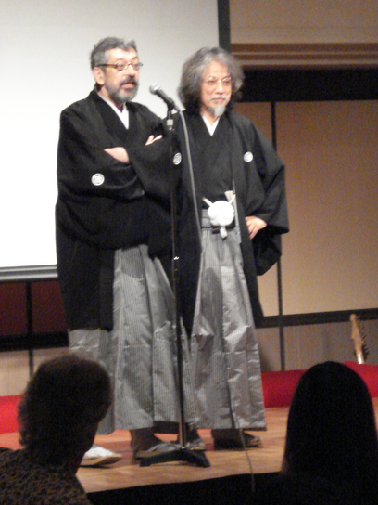
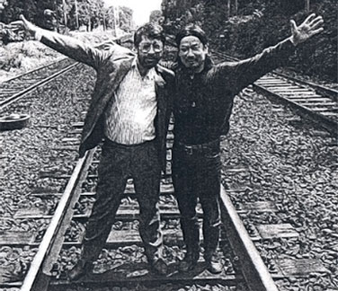
Art Gallery Problem
Suppose we have an art museum with a simple polygonal shape P
with n vertices (n ≧3)
How many guards are enough to watch P
  A guard has 360 degree vision, but not through the wall.
  Guards are stationary: Sit on chairs, and do not walk
Theorem (V. Chavatal, 1975)
[n/3] guards are enough (and necessary for the worst case)
Elegant proof by S. Fisk (1978)
Examples requiring many guards (Chavatal’s comb)
  Will be illustrated on the whiteboard (by students! )
  First, find a polygon (with smallest possible number of vertices) for which two guards are necessary.
  Then, how about three guards?
  Then general example for k guards.
Václav (Vašek) Chvátal
with Jin Akiyama at their 60th birthday conference

Slide 10
Power of Graph + Geometry
Graph G＝（V, E) V: set of vertices, E: set of edges
(Geometric) Graph drawing Vertices are located as points in the plane, and edges are line segments connecting vertices
Topological Graph drawing Vertices are located as points in the plane (or surface), and edges are curves connecting vertices
Planar graph drawing (or plane graph) : Graph drawing without intersection of edges
Planar graph: A graph that has a planar graph drawing

Slide 11
Graph coloring
Graph (vertex) coloring : Give colors to vertices of a graph so that no edge connect same colored vertices.
Coloring problem: Color a graph with a given set of colors
  Coloring number: Minimum number of colors to color a graph
Famous problems
  Four coloring problem
  Any planar graph can be colored by using at most four colors?
    Even a primary school student can understand, but unsolved for long time
    Solved by Appel and Harken but ………….
  K- Colorability computation
  Given a graph and a number k, decide whether the graph is colored by using k colors
    2 colorablity is easy to solve ( 2-colorable graph is called bipartite graph)
    3-colarability is difficult for a general graph

Slide 12
Polygon triangulation and graph
Dual Graph
Primal graph

Slide 13
Coloring of the primal triangulation graph
Three colors are necessary (of course)
Three colors are enough!
WHY?

Slide 14
Coloring and art gallery problem
Locate guards at red vertices
[n/3] guards are enough
  Why ?

