Slide 1
Triangulation of point set

Slide 2
Triangulation of point set
Triangulation of a set of points on the plane

Slide 3
Triangulation of point set
Which triangulation do you like?

Slide 4
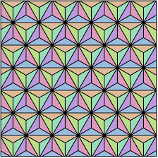
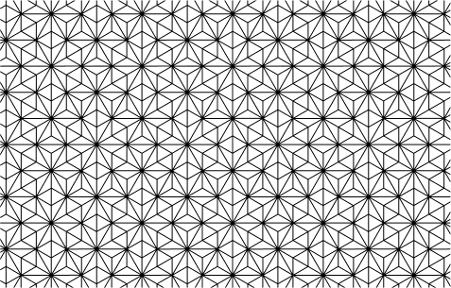
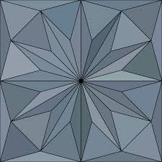
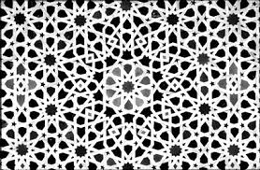
Goodness of triangulation
Total length of edges is short
Minimum angle is large (No skinny triangle as possible)
Maximum angle is small
Beautiful symmetry
Triakis tiling
Labyrinth tiling
Not a triangulation, but beautiful tiling pattern in Alhambra palace

Slide 5
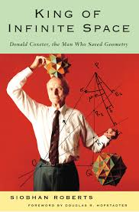
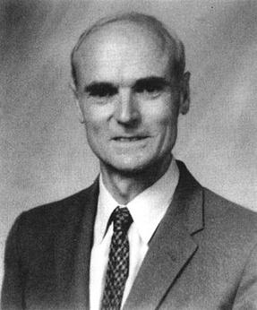
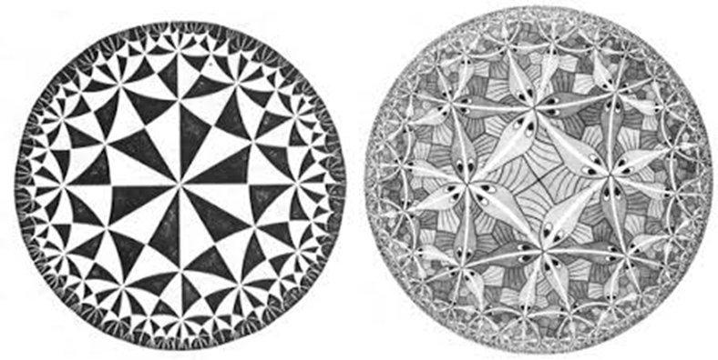
H. S. M. Coxeter (1907-2003)
Harold S. M. Coxeter is a giant to investigate on “geometric beauty”.
Crystal, tiling , polytopes…
He collaborated with another genius Cornelius Escher , who created arts inspired by Alhambra tiling patterns.
https://brewminate.com/escher-and-coxeter-a-mathematical-conversation/

Slide 6
Maximizing the minimum angle
We want to avoid skinny triangle, and hence would like to maximize the minimum angle
  There are many such triangulations, and hence we consider “triangulation with lexicographically maximum angle sequence”
  Arrange all angles in the triangulation T in ascending order to have a nondecreasing sequenced a(T)
  Find a triangulation maximizing a(T) in lexicographic ordering
Usually, this kind of optimization is difficult, but we are very lucky that the above optimization can be done efficiently
  Using mathematical structure studied more than 100 years. (or 2000 years)

Slide 7
Which is better, and how to judge?

Slide 8
Enclosing circle of triangle and its use
Question: How to draw the minimum enclosing circle of three points ?
Exercise: Find a formula to detect the enclosing circle of a triangle contains another point.

Slide 9
The flipping algorithm
Find any triangulation of a given point set
Check each convex quadrangle consisting of two triangles
If the minimum enclosing circle of one triangle contains the fourth point, then flip the edge
Theorem
If there is no possible flip, the triangulation has the lexicographically maximum angle sequence

Slide 10
Draw the triangulation with the lexicographically max angle sequence

Slide 11
Draw the triangulation with the lexicographically max angle sequence

Slide 12
Draw the triangulation with the lexicographically max angle sequence

Slide 13
What kind of algorithm did I use?
How to draw the minimum enclosing circle of three points?
  You learned in junior high school (?) that the center of enclosing circle of a triangle is intersection of three perpendicular bisectors of edges
  Can you draw perpendicular bisector by using ruler and compass?

Slide 14
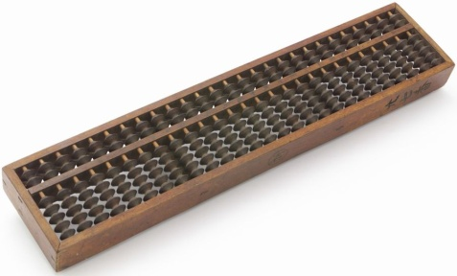
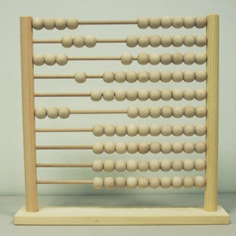
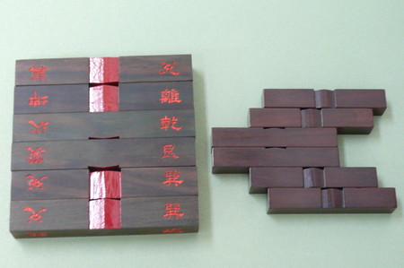
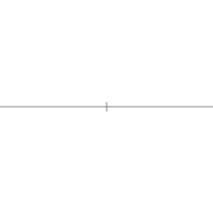
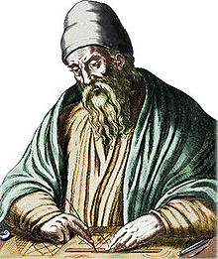
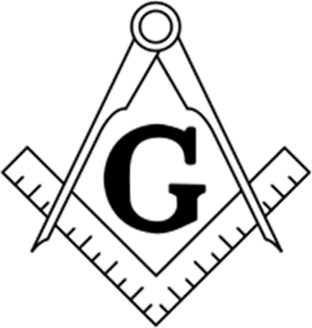
Computation and Computing tools
Ancient computation tools
  Abacus and counting rods（China, Japan）
    Computational Machinery
    Many original algorithms for them
  Ruler and Compus （Ancient Greece ）
    Algorithm ＝ Drawing figuers
    Mathematical basis: Euclid Geometry
    One can do addition, subtraction, multiplication, division,
    How to draw a square of area 2 , 3, etc?
Euclid

Slide 15

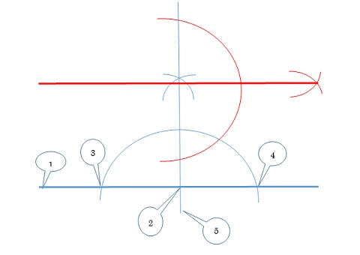
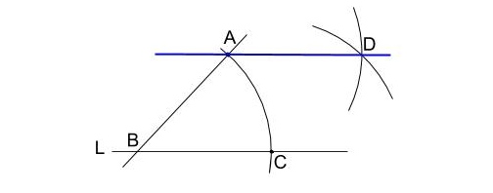
Perpendicular bisector and computation
Perpendicular bisector
Parallel line
Perpendicular bisector is the base of geometric computation
Compution of regular angle、Binary number system、Addition is done by using parallel translation、Multiplication by using similarity、 Solution of quadratic equations
15

Slide 16
The perpendicular bisector divides the plane
The locus of distance equilibrium of two points p and q
  ｛ｘ： dist(p, x) = dist(q, x)｝ is the perpendicular bisector
It divides the plane into two parts
V(q)=｛ｘ： dist(p, x) > dist(q, x)｝ Region of points nearer to q
V(p)=｛ｘ： dist(p, x) < dist(q, x)｝
Extension of this idea
  Distance equilibrium of two objects
  Plane partition of many points into cells corresponding to nearest points
    Voronoi diagram

Slide 17
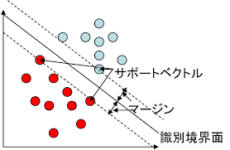
2つの物体の等分線
Distance equilibrium of two sets S and T
  If S and T are point sets
  Partition by line（by hyperplane in high dimensions）
    Support Vector machine
    Used in machine learning
  If S and T are polygons
    The partition is not given by lines

Slide 18

  Distance equilibrium of a point and a line
You learn in junior high school
  Parabola antenna, Telescope, etc
    Locally , perpendicular bisector

Slide 19


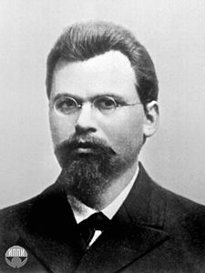
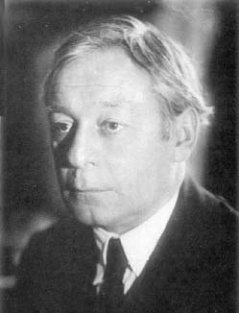
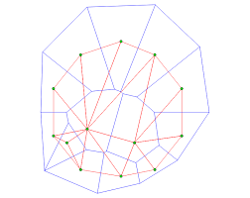
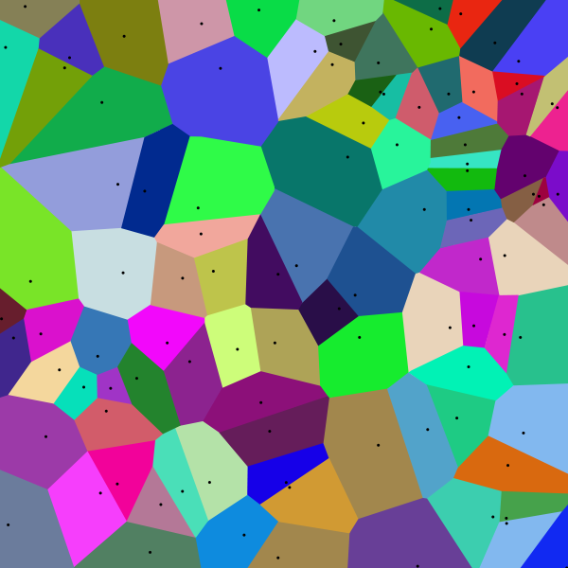
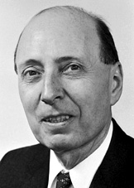
Equilibrium of many objects：Voronoi diagram
Cell decomposition wrt “nearest cites”
Descartes(1644) Dirichlet (1850)
  Dirichlet Tesselation
Georgy Voronoi (1868-1920) studied
Boris Delaunay (Delone) (1890-1980)
  Named Voronoi diagram
Dual of Voronoi diagram is called Delaunay triangulation
  Which we seek for
In physics, it is called Wigner-Seiz cell.

Slide 20
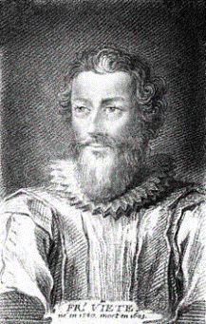
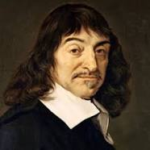

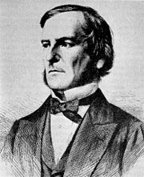
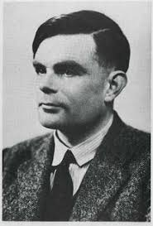
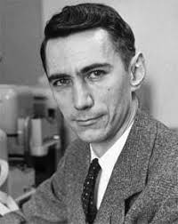
History of computaion model
Viète(1540-1603) Mathematical symbols
Descartes(1596-1650) Cartesian coordinate
Newton（1643-1727) Calculus
⇒Computation & Algorithms by using functions and algebra
Boole (1815-1864) Logics in Algebra
Turing（１912-1954）Computability and Computer
Shannon（1916-2001) Information theory
⇒Computation and Algorithms with Computer
Computational Geometry: Geometry & Algorithms with Computer

Slide 21
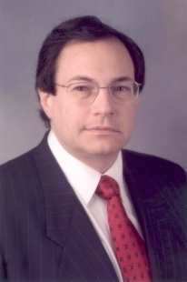
The birth of computational Geometry
M. I. Shamos: Voronoi diagram computation
O( n log n) time algorithm
(Ph. D thesis, 1978)
  Basic tool in computational geomery
    “Perpendicular bisector of many objects “

Slide 23
What I have done:
First draw the Voronoi diagram
Then, draw its “dual”

