Slide 1

Part 2: Digital convexity and digital segments
Goddess of fortune smiles again
q
p

Slide 2
Problem
We are in the digital world, and digital geometry is important
How to formally consider “convexity” in digital world
  Discrete convexity (Lovasz, Murota)
  Submodularity (Fujishige)
  Oriented matroid ( Fukuda)
But, we consider more direct concept

Slide 3
A brainstorming
Consider an n x n grid G and a set S of grid point
We want to define “convex hull” S⊂C(S)⊂G
  C(S) is desired to be connected in G
  Hopefully, it looks like Euclidean convex hull
  Hopefully, definition is mathematically nice
  Hopefully, intersection of two convex hulls is “convex”
Notes:
3

Slide 4
A brainstorming
Convex hull in n x n grid G
Idea 1. The set of affine linear combinations
Idea 2. The union of “shortest paths”
Idea 3. We define a system of line segments in G, and define the convex hull as the smallest “convex set “(i.e., any segment of two points lies in the set) containing S in G
Notes:
4

Slide 5
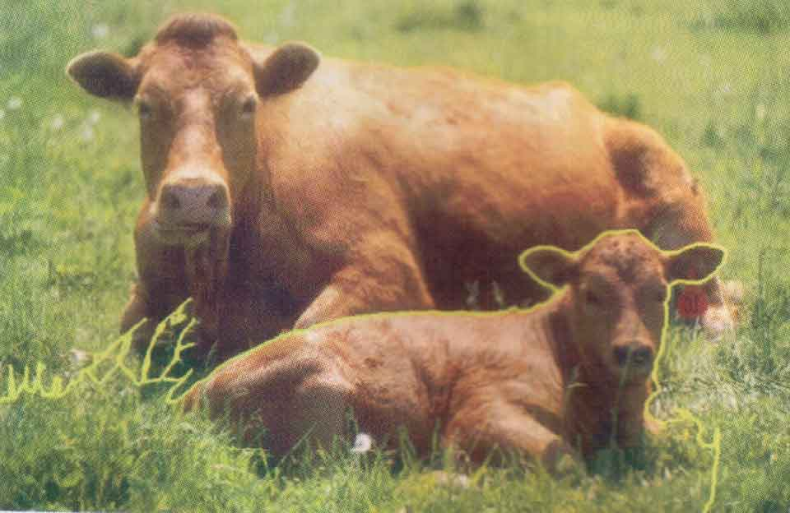

Image segmentation
Convex region R in a digital picture
Star shaped region R
was lucky to find a nice problem.
How should we define digital rays and lines?
How far can they simulate real rays and lines?

Slide 6
Digital Straight Segment
Digital line segment
  Many different formulations to define a line in the digital plane, started in (at latest) 1950s.
  A popular definition: DSS (Digital straight segment)
  Defect: It is not “convex” by definition.
line : y=ax+b
digital line : y=[ax+b]
q
p
6
Notes:
6

Slide 7
Axioms for
consistent digital line segment
(s1) A digital line segment dig(pq) is a connected path between p and q under the grid topology.
  (connectivity)
(s2) There exists a unique dig(pq)=dig(qp) between any two grid points p and q. (existence)
(s3) If s,t∈dig(pq), then dig(st)⊆dig(pq).
  (consistency)→intersection connectivity
(s4) For any dig(pq) there is a grid point r∈dig(pq) such that dig(pq) ⊂ dig(pr). (extensibility)
／
7
Notes:
7
a digital line segment is analogous to a line segment in Euclidean geometry,
it is natural to require the following axioms that a digital line segment should satisfy

Slide 8

Consistent digital segments
DSS is not consistent
Known consistent digital segments
  L- path system
  Defect of the L-path system
    Hausdorff distance from real line is O(n)
L-path system is visually poor.
8
Notes:
8
Unfortunately, popular definitions of two-dimensional digital line segments in computer vision do not satisfy previous axioms.
DSSs is not consistent.
Intersection of two digital segments is not always connected,
and axiom (S3) is violated in some cases.
In the 2D grid, another possibility to define digital line segments would be to use the system of L path system.
Known consistent digital segments
L- path system
Defect of the L-path system
Does not approximate line segments visually
Hausdorff distance between L-path and line (distance error) is O(n) for a segment in n x n grid
Existence of a system of consistent digital segments with o(n) distance error is unknown

Slide 9
Digital rays and segments
We need a visually nice consistent digital segments
But, this was a big challenge (more than 50 years)
Hopeless approach again??
Consistent digital rays (Chun et al 2009)
  O( log n) distance error (almost straight)
  Tight lower bound using discrepancy theory
    It was also reported by M. Luby in 1987.
Consistent digital segments
  Christ-Palvolgyi-Stojakovic 2010
  O(log n) distance error
  Surprisingly simple construction !
9
Notes:
9
Unfortunately, popular definitions of two-dimensional digital line segments in computer vision do not satisfy previous axioms.
DSSs is not consistent.
Intersection of two digital segments is not always connected,
and axiom (S3) is violated in some cases.
In the 2D grid, another possibility to define digital line segments would be to use the system of L path system.
Known consistent digital segments
L- path system
Defect of the L-path system
Does not approximate line segments visually
Hausdorff distance between L-path and line (distance error) is O(n) for a segment in n x n grid
Existence of a system of consistent digital segments with o(n) distance error is unknown

Slide 10
Digital line segments construction
Fix a permutation π of {1,2,…2n}
Digital segment from p=(x(1),y(1)) to q=(x(2), y(2)),
  x(1)<x(2) and y(1)<y(2), for convenience
Set s = x(1)+ y(1) < t=x(2)+y(2), k = x(2)-x(1)
See ( π(s+1),π(s+2),..,π(t) ) and transform k smallest entries to 0 and others to 1.
(0011010101) → 0: horizontal, 1:vertical move
The set of such zigzag paths satisfy the axioms.
If π is a low-discrepancy sequence, digital lines are almost straight.

Slide 11
Power of consistent digital segments
“Euclid like” geometry avoiding geometric inconsistency caused by rounding error

Slide 12
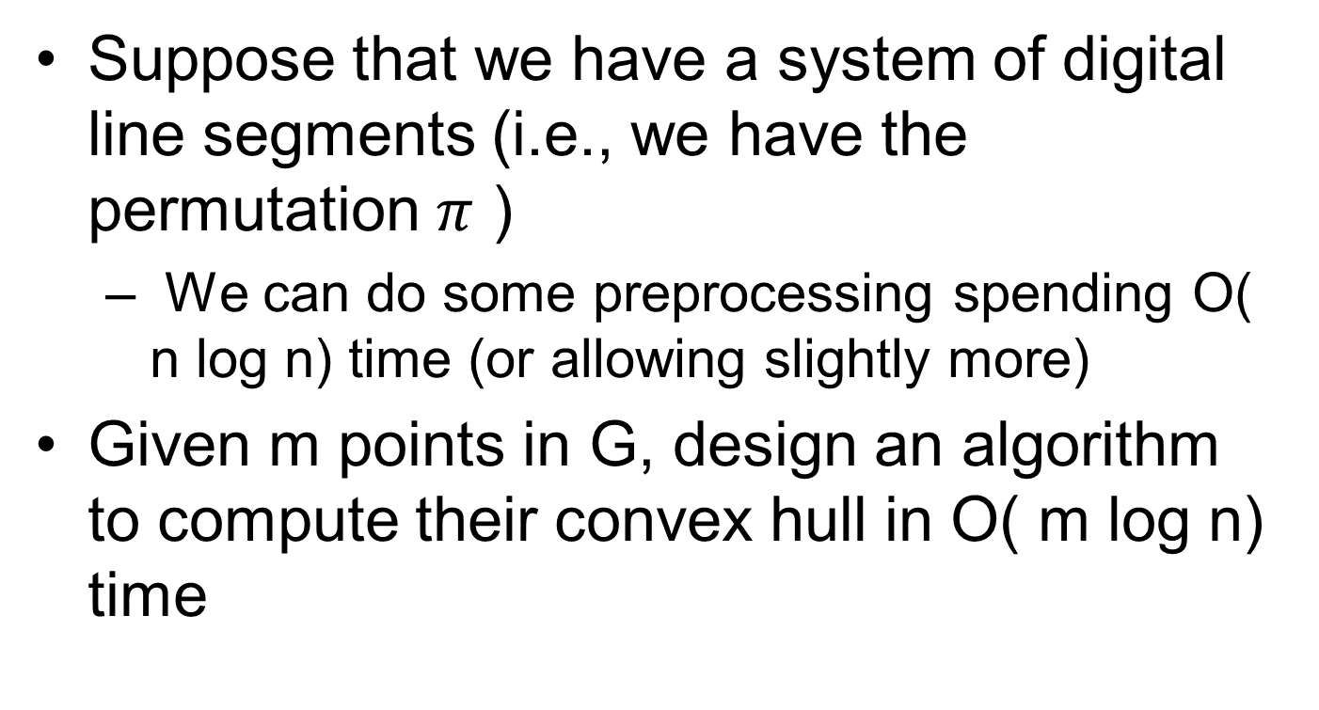
Final exercise
Suppose that we have a system of digital line segments (i.e., we have the permutation $π$ )
  We can do some preprocessing spending O( n log n) time (or allowing slightly more)
Given m points in G, design an algorithm to compute their convex hull in O( m log n) time

Slide 13
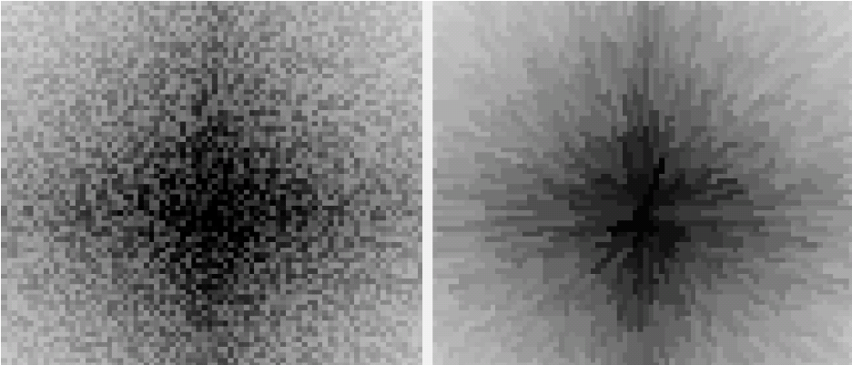
Use of digital star-shapes
Optimal approximation of a function by a layer of digital star shapes (like Mount Fuji)
input : f(x)
output
unimodal function
13
Notes:
13
This is example of input function f(x) and its approximation f_p(x).
We call the region below a unimodal function a pyramid, thus call the problem “mountain (pyramid) approximation problem”
This is an example of the 2-dimensional case
Here, input f(x), and its output fp(x) is like this.
Pyramid is a layered structure on the voxel grid. Like this output fp(x)

