Slide 1
Computational Geometry and some classical mathematics
Takeshi Tokuyama
Graduate School of Information Sciences
TOHOKU Univ.
Self Introduction:
Ph D in mathematics (group representation theory), 1985, U. Tokyo
IBM Tokyo Research Lab., 1986-1999 (a mathematician in industry)
Tohoku University (Information Science) 1999---
I am a computer scientist. It is questionable whether I am a mathematician….

Slide 2
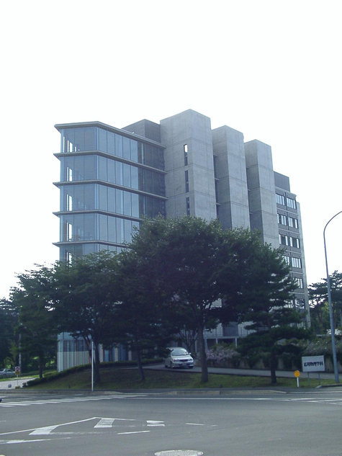
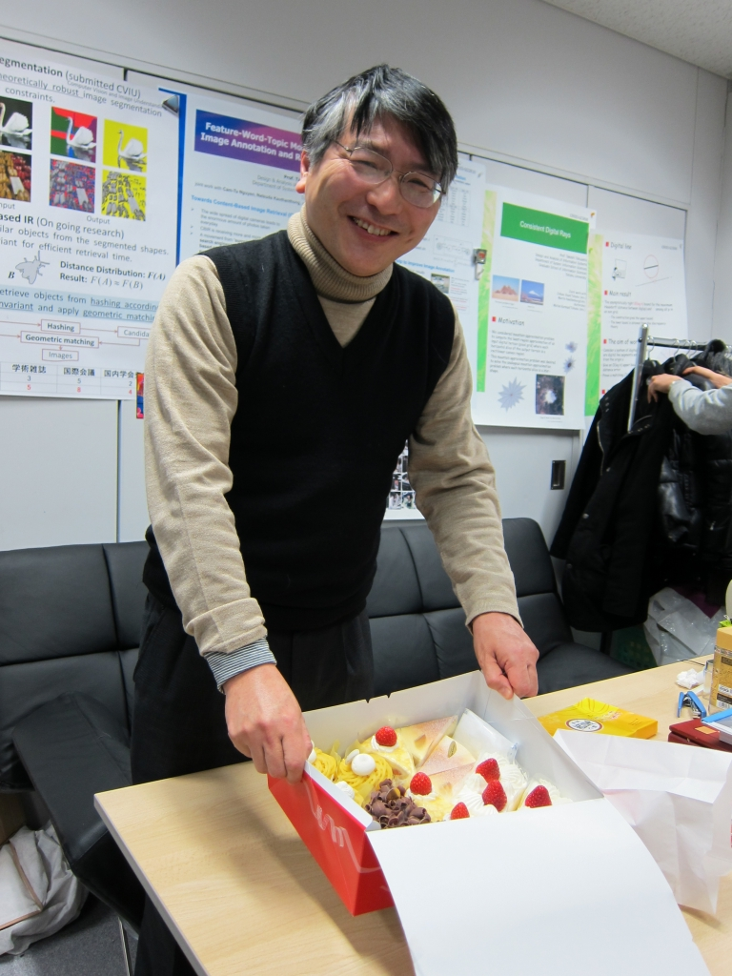
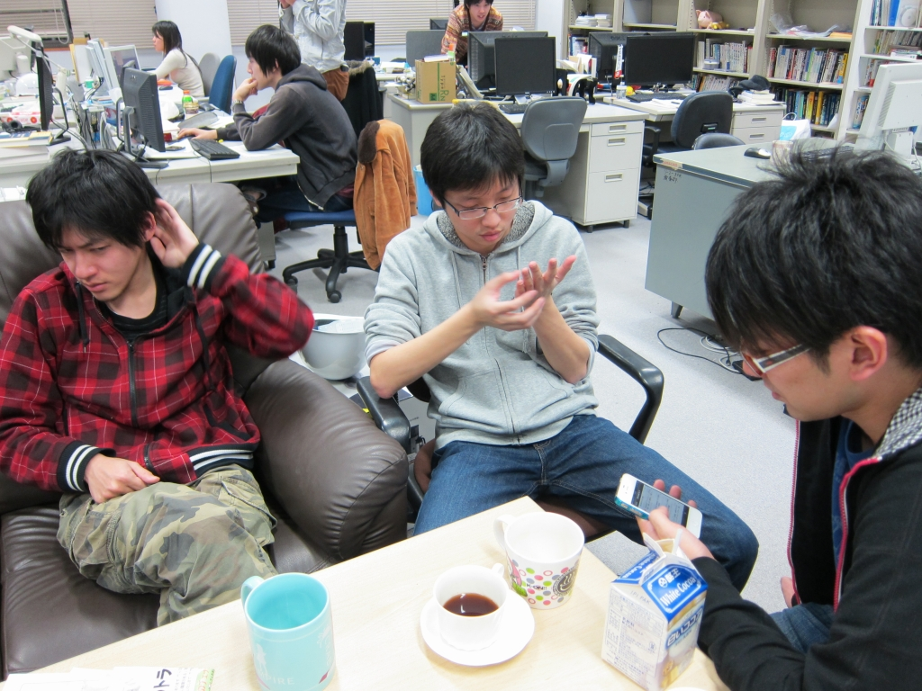
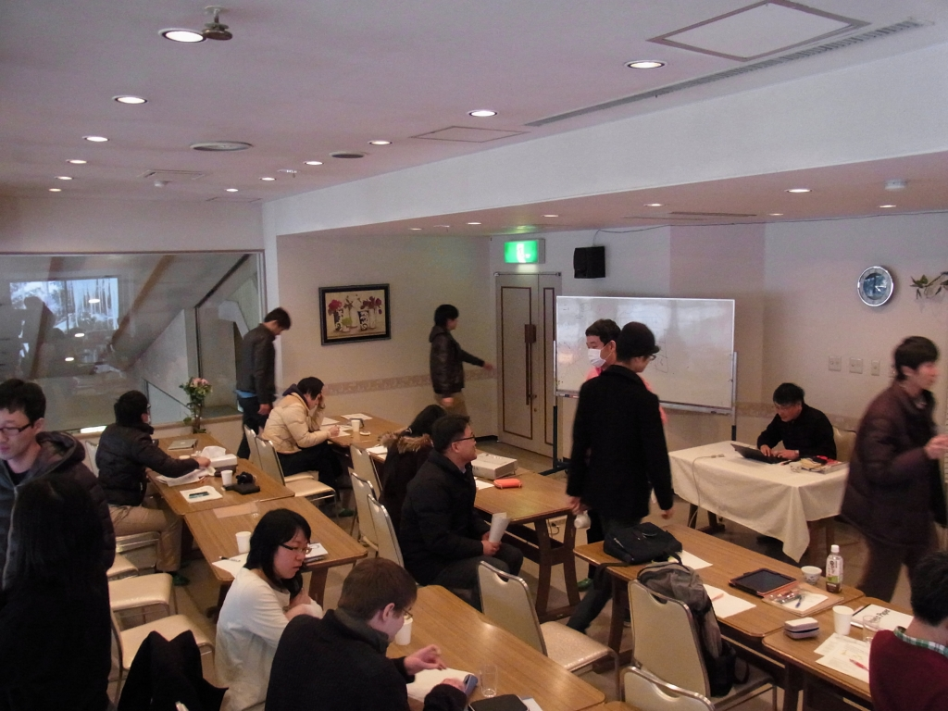
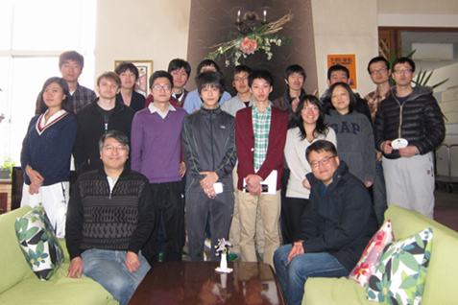
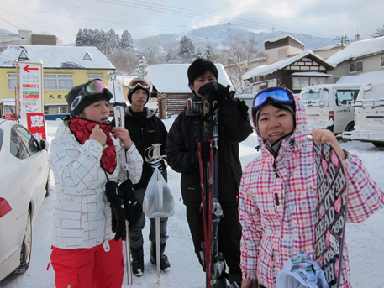
Life in Tohoku University
Discussion on ????
Never forget my birthday
GSIS building
Workshop in Zao (hot spa+ ski resort)
Free Discussion

Slide 3
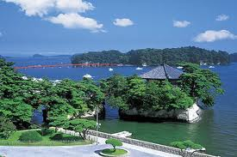
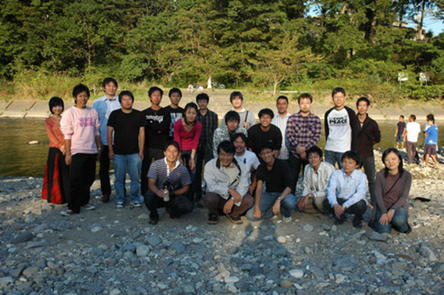
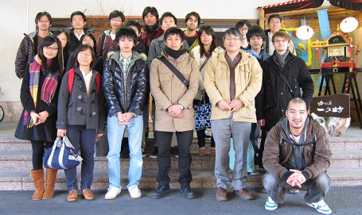
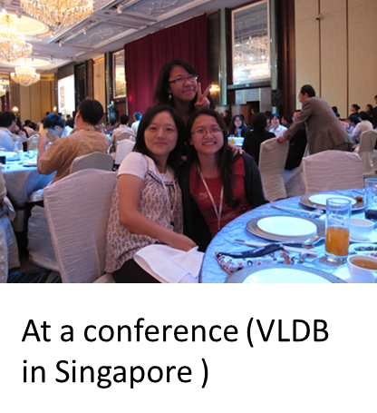
Activities
Matsushima, Best view spot in Japan
Imoni (riveside cooking) party
Annual Onsen (hot spa) trip
We have a fellowship program for student visit from/to ETH this academic year.
Ask Prof. Sonoko Moriyama for details.

Slide 4
Computational geometry
Efficiently compute optimal location, movement, or deformation of objects
Geographic Information Systems
Geometric pattern matching
Protein Structure Analysis
Motion planning of robots/cars
Computer Vision, Image Retrieval Systems
Mechanical Process Optimization
We handle geometry, thus need mathematics
Difficult tasks for a “usual” programmer without guidance of mathematicians.

Slide 5
Convexity and Convex hull
Convex region (oval) S in a vector space : For any two points p and q in S, the segment pq is in S
Convex hull C(X) of a set X = Minimum oval containing X (what “minimum means?”)
In other words, the set of affine linear combination of points (i.e. vectors) in X
$C\left(X\right)=\{\sum_{x∈X}{a\left(x\right)x : \sum_{x∈X}{a\left(x\right)=1, a(x)≥0\}}}$

Slide 6
Convex hull in computer science
Affine linear combination and convex hull is a key tool in
Mathematical programming
Game theory and strategy design
Combinatorial/Geometric optimization
Convex hull computation of n points
O(n log n) time for planar point set (Graham 72)
O( n log n) time for 3d point set (Preparata-Hong 77)
O(n ^{[d/2]}) time and space for higher dimension (Chazelle 93)
O(dnM) time and O(dn) space, where M is size of (triangulation of) the convex hull boundary (Avis-Fukuda 92)

Slide 7
Topics in this tutorial
Variations of convex hull computation
A warming up quiz
Why affine linear combination is important?
Convex hull of movable objects
Convex hull of translated segments
Kakeya’s needle problem and its extension
Convex hull in discrete space (if time allows)
Convex hull in the grid plane
Digital rays and line segments

Slide 8
Warm up
What is “affine linear combination”?
A common sense for a mathematician

Slide 9
Quiz: Sure win in Casino
You go to Casino and the dealer reveals 52 cards (26 red, 26 black) one by one
You have 1000 dollars, and bet to red or black 52 times. Minimum bet is 1 dollar, and the maximum is 10,000 dollars.
How much you can gain (surely?)
If you bet (say, 20 dollars) each time randomly, no sure gain.
Peter Winkler, Mathematical Puzzles, A Connisseur’s Collection

Slide 10
Quick solutions
Counting cards
Wait until the last card counting previous cards, then you know the color of last card.
Then, bet 1000 dollars. You have 2000 dollars.
Are you happy with 1000 win?
Wait until the last three cards. Suppose 2 red and 1 black remain.
Bet 1000/3 dollars on red (in practice, 333 )
If you win, wait until last, and you will have 8000/3
If you lose, bet all to red twice to have 8000/3
You gain about 1666
Is this best? What is your idea???

Slide 11
Mathematics
Gambler’s strategy
You assume one of possible sequences of red-black, and bet all believing your luck.
If you are lucky, you gain 2⁵² x 1000 dollars
There are only _{2n} C _{n} possible sequences (n=26).
Expectation is about
However, there are two defects
Very low probability to obtain gain
Upper limit of bet prevent this strategy

Slide 12
From Mathematics to Information Science (IT? CS?) Solution:
Convert the expectation to “sure win”
Consider an affine linear combination of gambler’s strategies, and convert to “sure win”
Mixed strategy in game theory
This is what economists want to do….
Homework (solution in the night session?)

Slide 13
Convex HULL of Movable Objects: GENERALIZED Kakeya Needle Problem

Slide 14
Our problem in general form
Optimal alignment minimizing convex hull
Given a set of geometric object S₁,S₂,..S_{n}, move (for the time being, we only consider translation) them to “minimize” their convex hull. (What “minimize” means?)
Note : A related problem is the packing problem, for which overlap of objects is not allowed

Slide 15
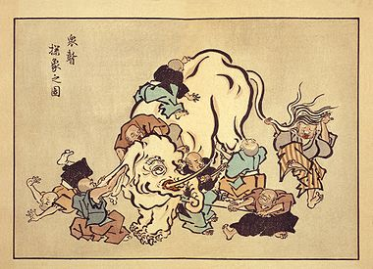
Motivations: Information unification
・Unify information obtained from different sources
S₁,S₂,..S_{n} represent convex hulls of of data obtained by observing a same object from different sources. How to unite (aggregate) them into one convex shape?
A kind of auto-focusing problem
From Wikipedia, Elephant and 6 monks. 17 century, Japan

Slide 16
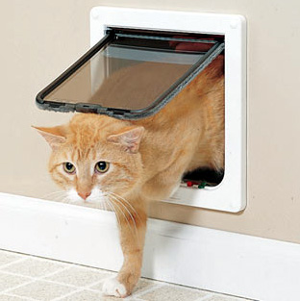
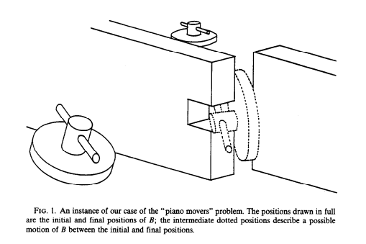
Designing smallest hole to go through
We want to drill the “smallest” (convex ) hole on a board so that we can go through a given geometric object (cat, bear, crocked bar).
If the hole is given, the feasibility problem is a version of “piano mover’s problem”.
The optimization problem looks difficult in general
If we fix the “orientation“ of the object and only allow translation, the problem is alignment problem of the set of sections of objects.

Slide 17
A simplified problem
Optimal segment alignment problem
Given a family F of n line segments, not necessarily finite, in the plane, translate them to minimize the area of convex hull.
Minimize the area A(P) of convex hull
translation

Slide 18
A similar (but easier) problem
Perimeter minimizing alignment
Given a family F of line segments, not necessarily finite, in the plane, translate them to minimize the perimeter of the convex hull.
Minimize the perimeter
L(P)
translation

Slide 19
PERIMETER minimization

Slide 20
Key Tool: width function
Width function
For an oval P, let R denote the width function of P. The value is the length of the projection of P on a line with slope .
P
Exercise: What is the width function of a unit (horizontal) segment ??

Slide 21
Perimeter minimization is easy (if you know mathematics)
Cauchy- Crofton formula for the perimeter L(P) of a convex region P
$\int_{0}^{π}{w\left(θ\right)dθ=L(P}$)
Thus, it suffices to minimize the width function
w(P) should be above “upper envelope” of w(s) for segments $s∈S$
If we locate midpoint of each segment at the origin as shown right, its width function is exactly the upper envelope
Thus, this is an optimal location
It is just one first imagines, thus not much exciting.
Exercise 2: See the formula is true for a disk and a segment
Exercise 3: Prove the theorem (for a convex polygon P).

Slide 22
Area MINIMIZATION

Slide 23
Difficulty for the area minimization
Different from perimeter minimization
Why?
The width function of the obtained oval must cover the upper envelope of width functions of segment
Then what is wrong??
For two segments, what is the solution?
Convex hulls have the same area

Slide 24
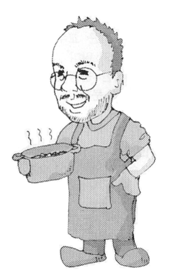
How we started
We run a joint program with Korean top universities
POSTEH(浦項工科大学）, KAIST(韓国科学技術院）
I visited POSTECH for a week to know this problem
Complete solution for four segments
Many conjectures for n segments, but failed….
Use of “width function”
On the flight back to Japan, Aha!!
I learned about it when I was an undergraduate in Math.
We need to learn from literatures of mathematics
Go back 100 years
We now can find old papers on Internet.
Hee-Kap Ahn
(POSTECH)
Otfried Cheong
(KAIST)

Slide 25
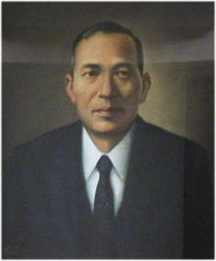
Kakeya needle Problem
How large area is necessary to rotate a unit-length needle?
Some problems on maximum and minimum regarding ovals (Tohoku Science Report 1917)
Soichi Kakeya (1886-1947)
Assoc. Prof. of Tohoku U.
First President of ISM（統計数理研究所初代所長）

Slide 26
Kakeya’s Problem
The initial observation by Kakeya (1917)
A(D) = 1/2×1/2×π ≒ 0.785
Reuleaux triangle R
A(R) = (π−√3)/2 ≒ 0.705

Slide 27
Kakeya Problem
The solutions
regular triangle
Deltoid (non-convex)
area = 1/√3 ≒ 0.577
area = π/8 ≒ 0.393
Matusaburo Fujiwara (One of the first professors of mathematics in Tohoku University）

Slide 28
Kakeya’s Problem: State of Arts
The equilateral triangle of height 1 is the smallest-area oval.
Matsusaburo Fujiwara (Tohoku U.) conjectured
Proved by Pal (1921) by using smart argument of width function.
Besicovitch (1928) showed that area becomes zero if we do not require convexity.
New applications recently in CS and Engineering
T. Tao “From rotating needles to stability of waves: Emerging connections between combinatorics, analysis, and PDE” Notices of AMS, 48(3) 2001

Slide 29
Besicovitch set

Slide 30
Relation to our problem (my Aha!)
Small area convex figure including all unit segments → Regular triangle
Small area convex figure including translated copies of given n segment → Triangle??

Slide 31
Width ordering
Width (partial) ordering
For two ovals P and Q, means that for every
P

Slide 32
Width ordering and area
We have two orderings P⊂ Q and w_{P} < w _{Q} .
Naturally, P⊂ Q implies w_{P} < w _{Q}
The other direction does not hold.
Difficulty: Area is not monotone w.r.t. width ordering.
Let D be the unit-diameter disk and T be a unit height regular triangle.
Then, w_{D} <w_{T}, but A(D) > A(T)

Slide 33
Mathematicians believe in “goddess of math”.
She guides us to an elegant solution if we find a “good” problem
Without monotonicity, elegant solution seems difficult
Thus, there should be monotonicity somewhere
For special pairs
If one of them is a segment
If both of them are “symmetric”

Slide 34
Width function and segment containment
Lemma 1
Let s be a segment in the plane, and let P be an oval such that . Then P contains a translated copy of s.
Exercise 4: Prove this lemma.

Slide 35
How to overcome the lack of monotonicity
An oval P is centally symmetric if P = -P
Lemma 2: If P and Q are centrally symmetric . Then, P⊂ Q if and only if w_{P} < w _{Q}
Exercise 5: Prove this lemma

Slide 36
SOME CONCEPTS and A theorem
Algebra on geometric objects:
Minkowski Sum A+B of two (planar) sets in a vector space
$$\{p+q:p∈A, q∈B\}$$

Slide 37
Minkowski symmetrization
1/2
centrally symmetric
Lemma. w = w_{P}
Exercise 6: Prove this lemma

Slide 38
Mixed area
We define the mixed area A(K,K’) by
A(K+K’) = A(K) + 2A(K,K’) + A(K’)
By definition, A(K,K)= A(K)
A(K,K’) is monotone (bi-monotone)
If K”⊂K’ then A(K, K”) < A(K, K’)
Like “inner product” if area is the “norm”
We use this concept later.

Slide 39
A property of symmetric oval
Lemma 3: Any centrally symmetric oval C has an inscribed affine regular hexagon having a side parallel to any specific direction
Affine regular: Image of a regular hexagon by an affine transformation
Edges(as vectors) are a, b, and b-a
a
b
Proof: Exercise. Please raise your hand.
2b
b-a

Slide 40
Trigonal disk (Relative Reauleaux triangle)
Given a centrally symmetric oval C and an inscribed affine regular hexagon H
H=P₁ P₂ P₃ P₄ P₅ P₆
Attach arcs P₁P₂, P₃P₄, and P₅P₆ to a triangle OP₁P₂
By doubling the size, we have a trigonal disk T such that w(T)=w(C)
P₂
P₁
P₃
P₆
P₄
P₅

Slide 41
From literature of mathematics
Theorem 1 (G. D. Chakarian , Set of Constant Width, Pacific J. Math 19-1, 1966)
For any oval K there is trigonal disk T such that W(K)=W(T) and A(T) $≤$A(K).
Corollary 1. We always has a trigonal disk as the solution of the minimum area alignment problem for segments.
Proof. Suppose K is the solution, then T is also a solution. (WHY?)

Slide 42
PROOF of THEOREM 1
This part is mathematical, so you can sleep if you do not follow

Slide 43
Circumscribed C-hexabon
Given C and an inscribed affine regular hexagon H
H=P₁ P₂ P₃ P₄ P₅ P₆
The circumscribed hexagon H’ of C touching vertices of H is called the circumscribed C-hexagon
P₂
Theorem 2.
Any oval K such that W(K)=W(C) admits a circumscribed C-hexagon
(Ohmann, 1952)
P₁
P₃
P₆
P₄
P₅
Exercise. Prove Theorem 2 (you may use Borusk-Ulam theorem)

Slide 44
Given C and an inscribed affine regular hexagon H
H=P₁ P₂ P₃ P₄ P₅ P₆
The circumscribed hexagon H’ of C touching vertices of H is called the circumscribed C-hexagon
P₂
Lemma 4.
A(H’) $≤$ 4/3 A(H)
P₁
P₃
Exercise. Prove the lemma
P₆
P₄
P₅

Slide 45
Proof of Theorem 1.
Theorem 1. For any oval K there is a trigonal disk T such that W(K)=W(T) and A(T) $≤$A(K).
Proof: A(T)= 2((A(C) –A(H)) + 4(1/6)A(H)= 2A(C) – 4/3 A(H)
P₂
P₁
P₃
P₆
P₄

Slide 46
Proof (continued).
4A(C)=A(K+ (-K)) = 2A(K) + 2 A(K, -K)
$≤$ 2A(K) + A(H’, -H’) for the circumscribed C-hexagon of K
= 2A(K) + 2A(H’)
$≤$ 2A(K) + 8/3 A(H)
Hence, A(K) $≥$2A(C) -4/3A(H) = A(T)
In my opinion, this is a magic.

Slide 47
Solution and algorithm for the segment alignment problem
Please wake up

Slide 48
Minimum area for given width
Theorem 3 (Our target theorem).
Given an oval K. There exists a triangle T with
A(T) $≤$A(K) and
T
K
smaller
but
wider

Slide 49
The 1st step
Theorem 1 (G.D.Chakerian 1966 Pacific J.Math.)
Given an oval K. There is a trigonal disk D with A(D)≦A(K) and
K
smaller

Slide 50
The 2nd step
Lemma 5.
Given a trigonal disk K. There exists a triangle T with A(T) $≤$A(K) and
Proof is (of course) an exercise
T
smaller
but
wider

Slide 51
Minimum area for family of segments
If we have an oval K containing given segments (allowing translations), there is a smaller(or equal) area triangle T containing them.
T
K
area
width

Slide 52
Now, how to compute
The solution is a trangle T
Which triangle?
The Minkowski symmetrization of T is an affine regular hexagon H
H has a nice property, and easy to find
Then, we can retrieve T from H
This leads to an efficient algorithm
Time complexity: O(n log n), same as the sorting

Slide 53
Affine-regular hexagon
There are something to check before the algorithm…
affine-regular hexagon
the image of a regular hexagon under a non-singular affine translation
Lemma.
Let T be a triangle. Then is an affine-regular hexagon, and . Every affine-regular hexagon H can be expressed in this form.

Slide 54
Affine-regular hexagon
Proof of Lemma.

Slide 55
Affine-regular hexagon

Slide 56
Computing a minimum-area triangle
1. Find a centrally symmetric oval P which contains a translated copy of every s∈F.
2. Compute the smallest area affine-regular hexagon H containing P.
3. Return a triangle T with = H.

Slide 57
Step 1
Place every s∈F with its center at the origin.
Let P be the convex hull of these segments.
translation

Slide 58
Step2
Compute the smallest area affine-regular hexagon H containing P.

Slide 59
Step 3
Return a triangle T with = H.
×2

Slide 60
Confirm

Slide 61
Conclusion
Power of mathemathics
We may go back 100 years and use old excellence
Without it, I should have spent at least 100 years, too.
BUT, goddess of math is not easy to smile
Higher dimensional analogue is not yet found
n polygons instead of n segments
So far, we can handle only two polygons case.
A lot of unsolved problems on this topic

Slide 62
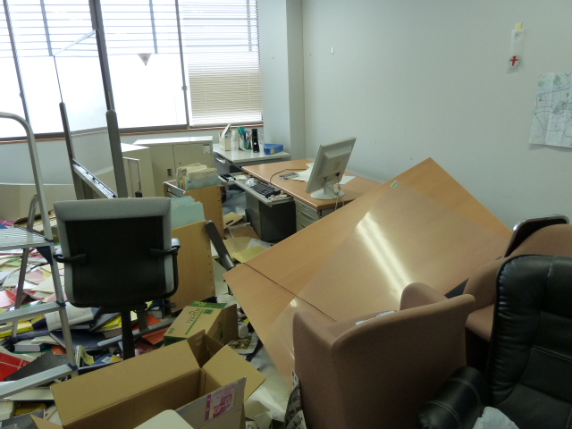
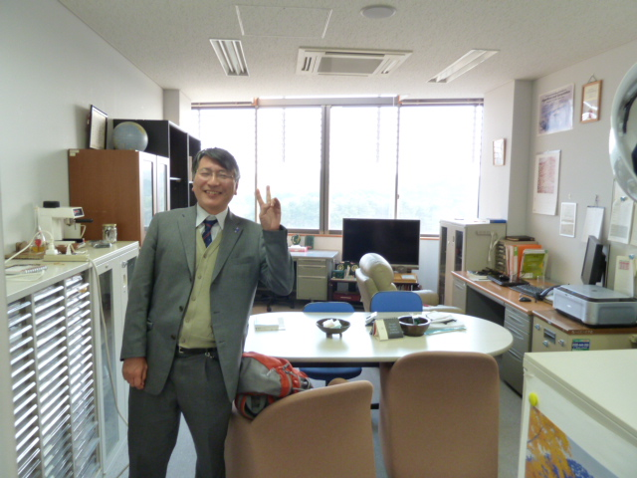
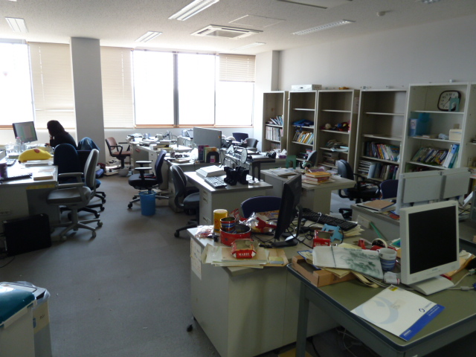
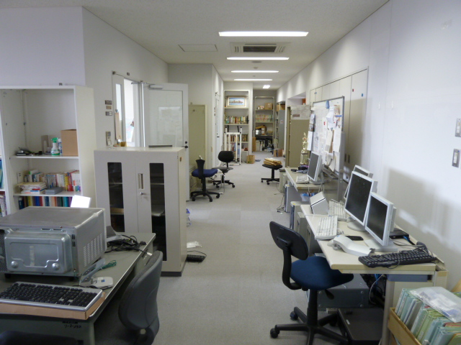
Earthquake!
Yes, it was tremendous
One month later

